Slide 1
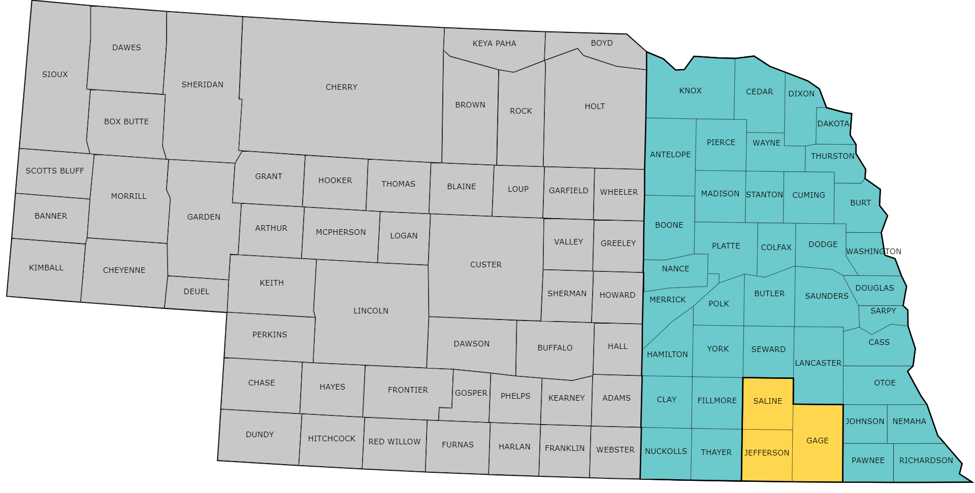
Benefits of Crop Rotation: The Case for Adding Winter Wheat
Intro About Wheat Economics Resiliency Growth & Development Management
Nathan Mueller, Ph.D., CCA
Water & Integrated Cropping Systems Extension Educator
Acct. Region: Saline, Jefferson, & Gage counties
nathan.mueller@unl.edu
@croptechcafe

Slide 2
Crop Watch
Intro About Wheat Economics Resiliency Growth & Development Management
View at cropwatch.unl.edu/wheat

Slide 3
Winter Wheat Cafe
Intro About Wheat Economics Resiliency Growth & Development Management
View at croptechcafe.org/winterwheat

Slide 4
What’s up this Wheat?
Intro About Wheat Economics Resiliency Growth & Development Management
Sign up at croptechcafe.org/winterwheat

Slide 5
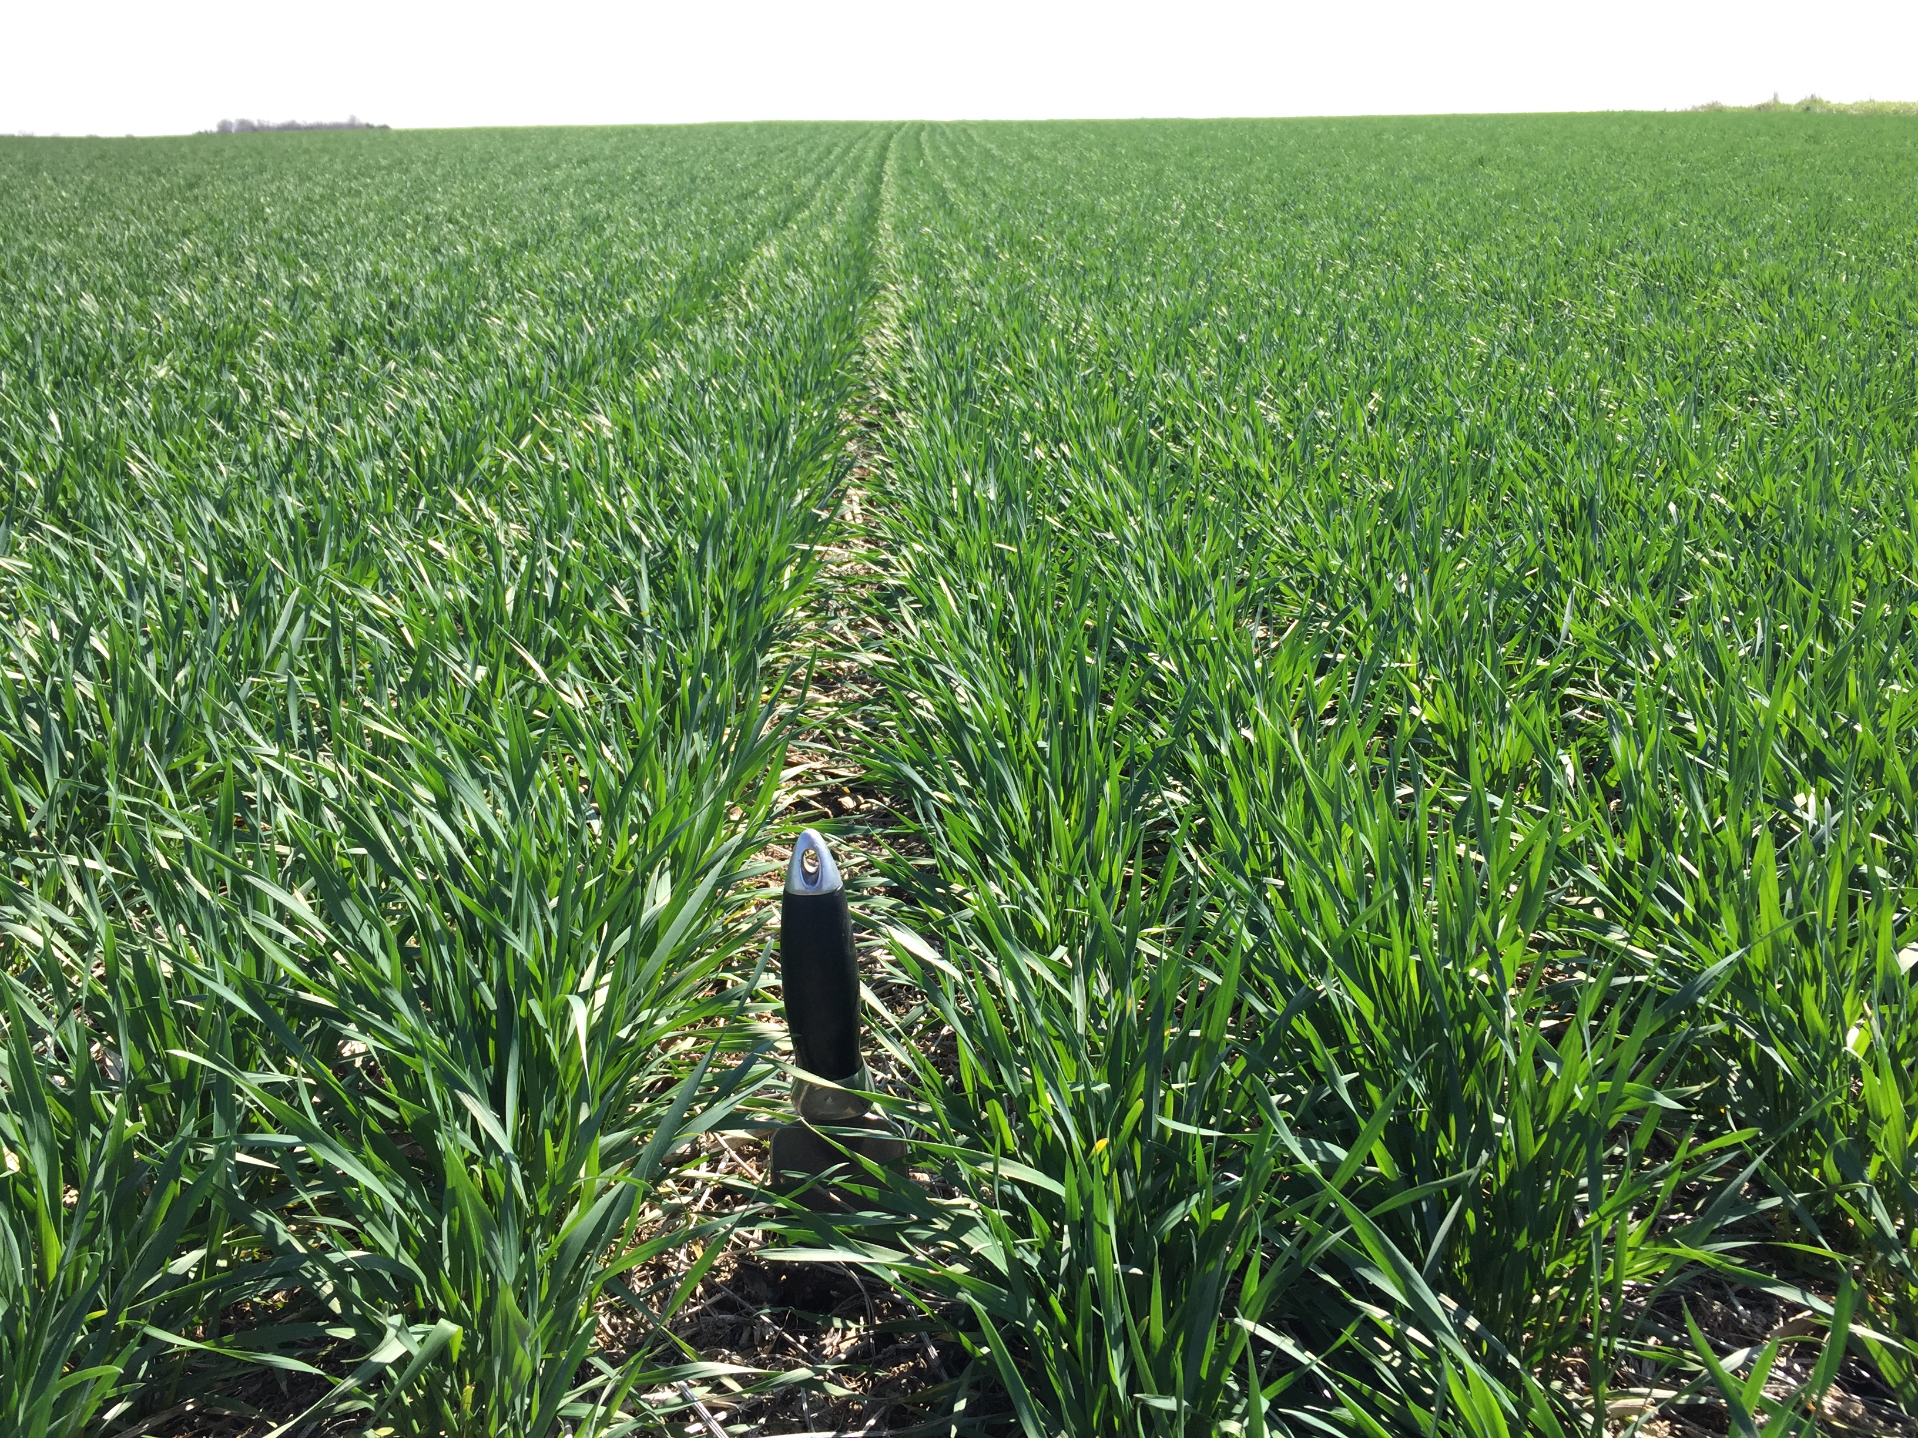
Benefits of Crop Rotation: The Case for Adding Winter Wheat
Intro About Wheat Economics Resiliency Growth & Development Management
Introduction
About wheat production in the region
Economics to consider: Adding winter wheat to a crop rotation
Resiliency: Weather and soil health
Growth & development
Management:
Variety Selection
Diseases
Planting dates and rates
Nutrients

Slide 6
2. Wheat Production in the Region

Slide 7
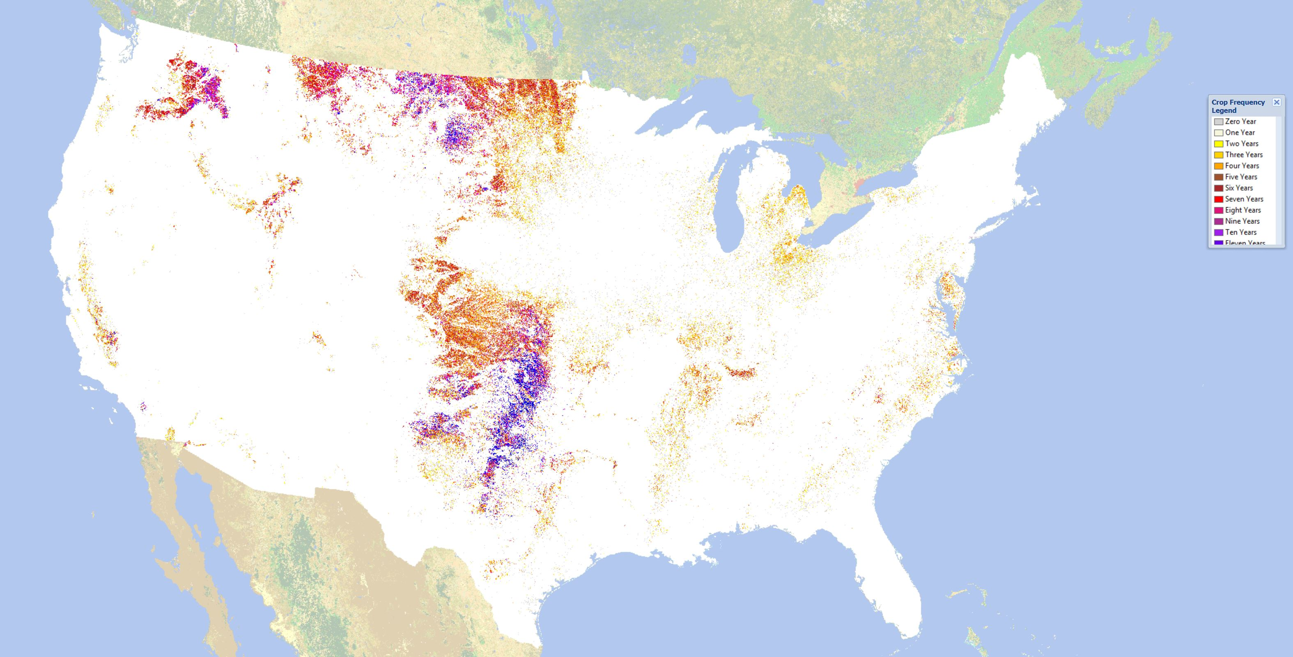
USDA CropScape
Intro About Wheat Economics Resiliency Growth & Development Management

Slide 8
Soil Moisture Regime – USDA-NRCS and K-State Research Analysis
Intro About Wheat Economics Resiliency Growth & Development Management
Typic
ustic
Udic
Udic
ustic
97 degrees west longitude

Slide 9
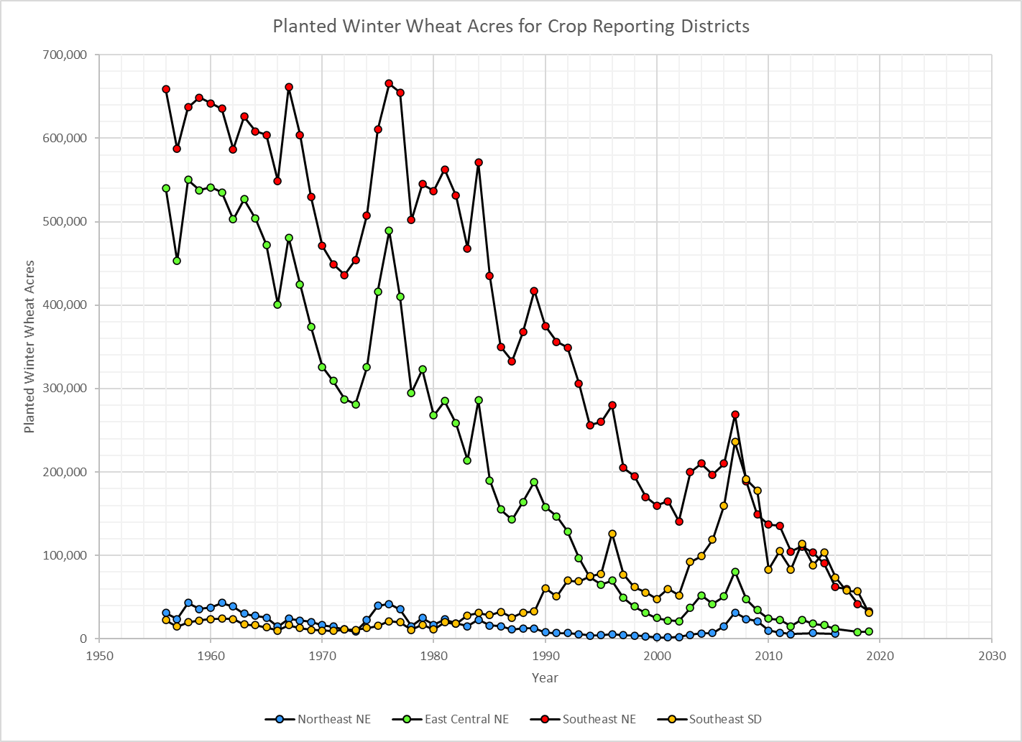
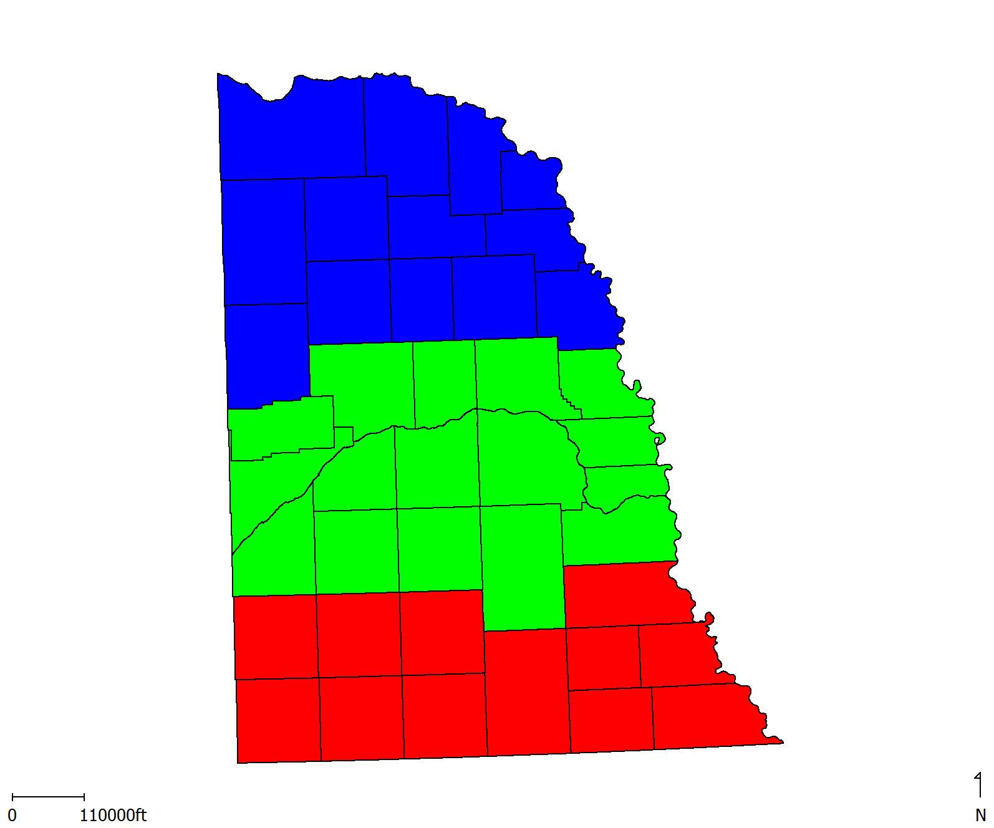
USDA-NASS Planted Winter Wheat Acres
Intro About Wheat Economics Resiliency Growth & Development Management

Slide 10
3. Economics to Consider

Slide 11
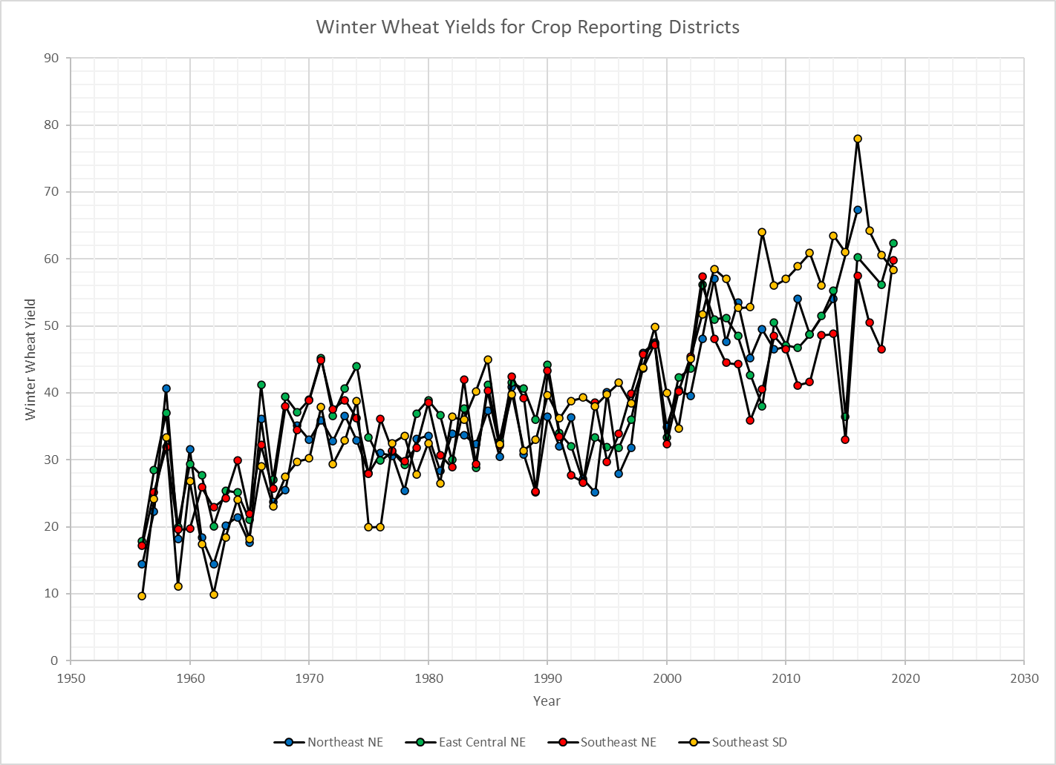
USDA-NASS Winter Wheat Yield Trends
Intro About Wheat Economics Resiliency Growth & Development Management

Slide 12
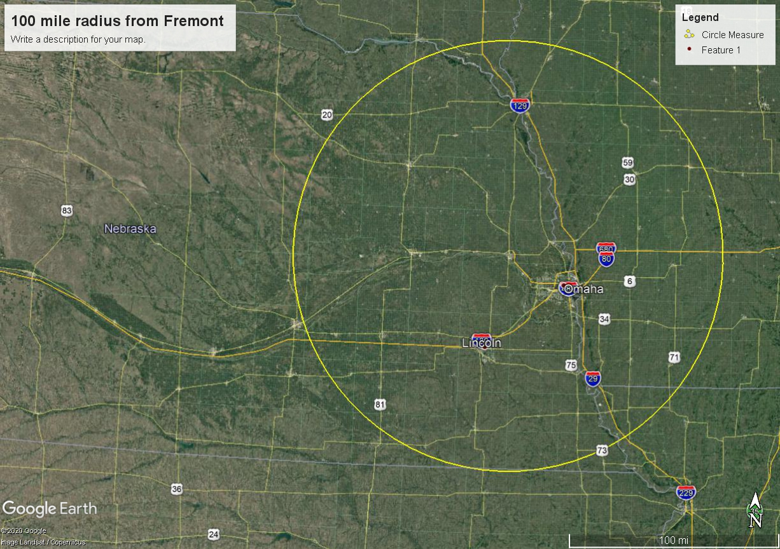
Markets
Intro About Wheat Economics Resiliency Growth & Development Management
Grain - Strong Local Basis, Jan. 11
Hansen-Mueller in Lincoln= +0.30
Scoular-Fremont = +0.75
Straw Prices
Rock Valley Hay Auction
Jan. 10, 2022
Large squares
$70 - $112.50/ton

Slide 13
Crop Rotation Survey – Southeast NE
Intro About Wheat Economics Resiliency Growth & Development Management
Conducted by Paul Hay, retired Extension Educator
Data collected from 2,894 fields from 1994 – 2007
Purpose
To quantify crop rotation responses
Identify best rotations
Seek answers to common concerns

Slide 14
Crop Rotation Survey – Southeast NE
Intro About Wheat Economics Resiliency Growth & Development Management
Rainfed Crop | Rainfed Previous Crop | Number of No-Till Fields | No-Till Yield (bu/ac) | Difference
Corn | Corn | 144 | 86
Corn | Soybean | 364 | 108
Corn | Wheat | 86 | 126 | +18
Soybean | Corn | 266 | 39
Soybean | Soybean | 29 | 36
Soybean | Wheat | 26 | 42 | +3
Wheat | Corn | 48 | 60
Wheat | Soybean | 128 | 53
Wheat | Wheat | 11 | 52

Slide 15
Corn Yields in w/Wheat in Rotation
Intro About Wheat Economics Resiliency Growth & Development Management
http://web.extension.illinois.edu/nwiardc/downloads/58547.pdf

Slide 16
Soybean Yields w/Wheat in Rotation
Intro About Wheat Economics Resiliency Growth & Development Management
http://web.extension.illinois.edu/nwiardc/downloads/58547.pdf

Slide 17
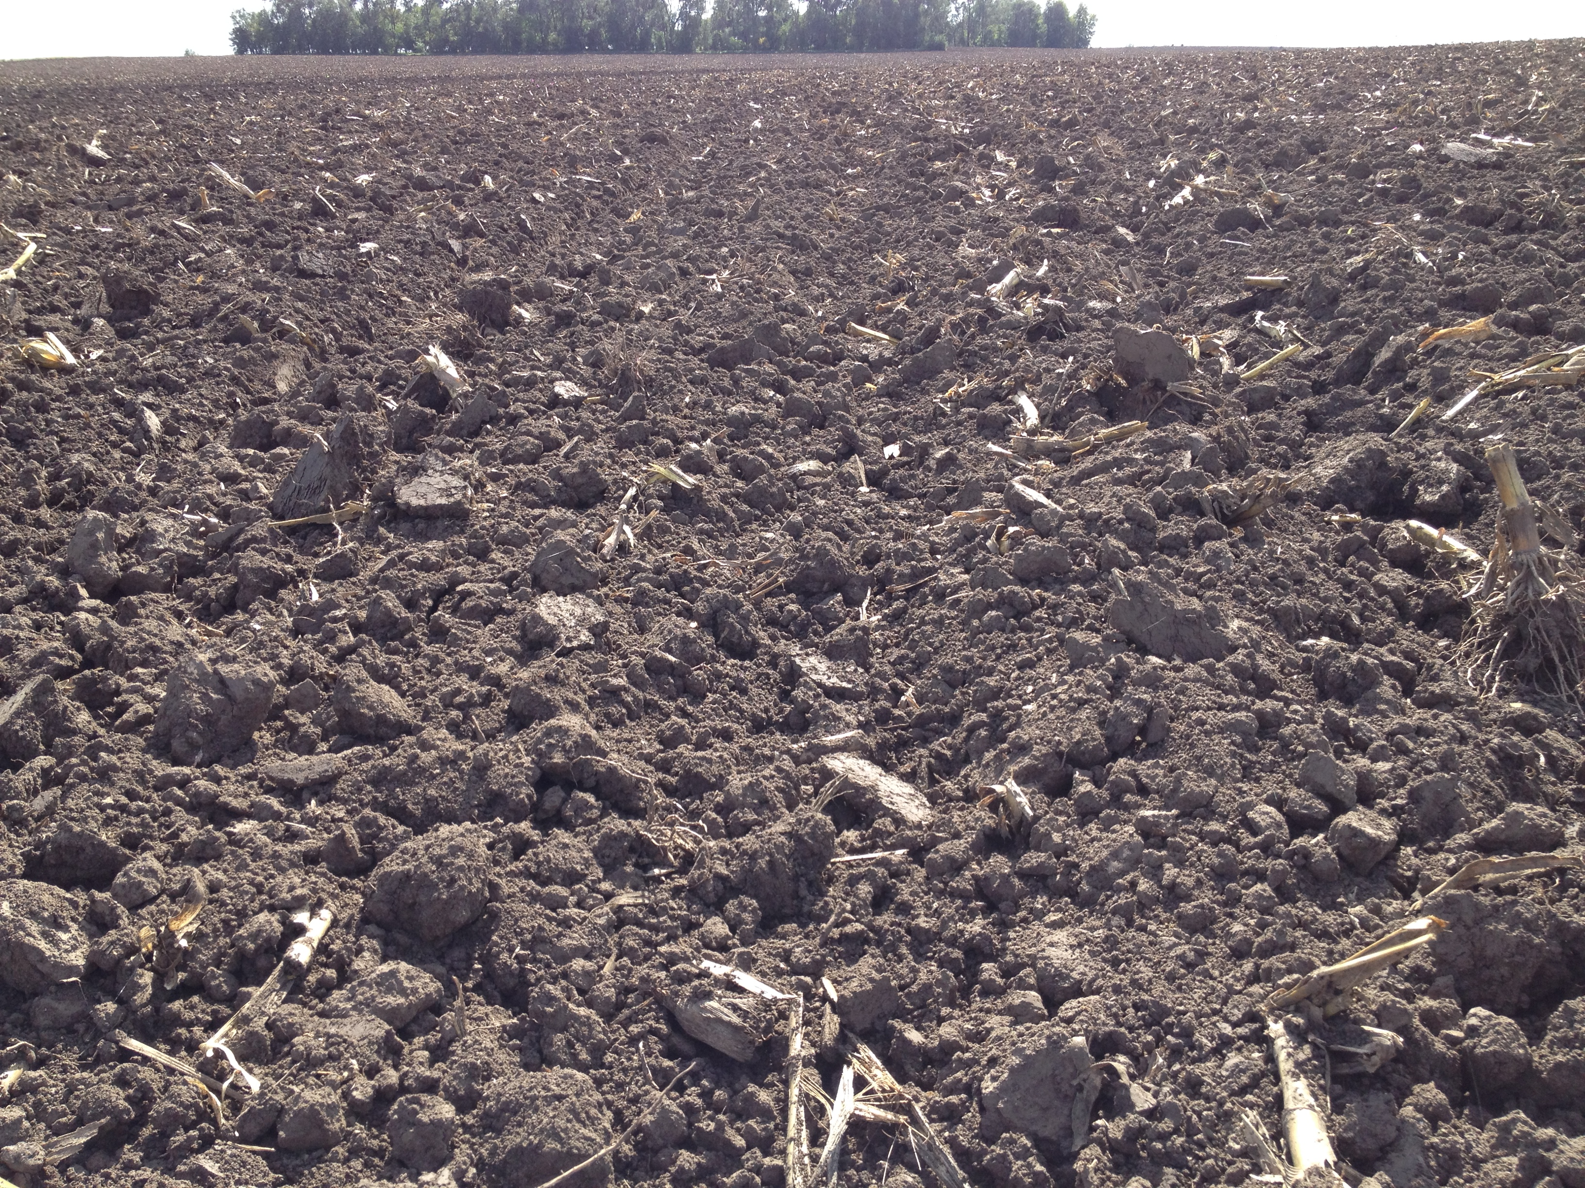
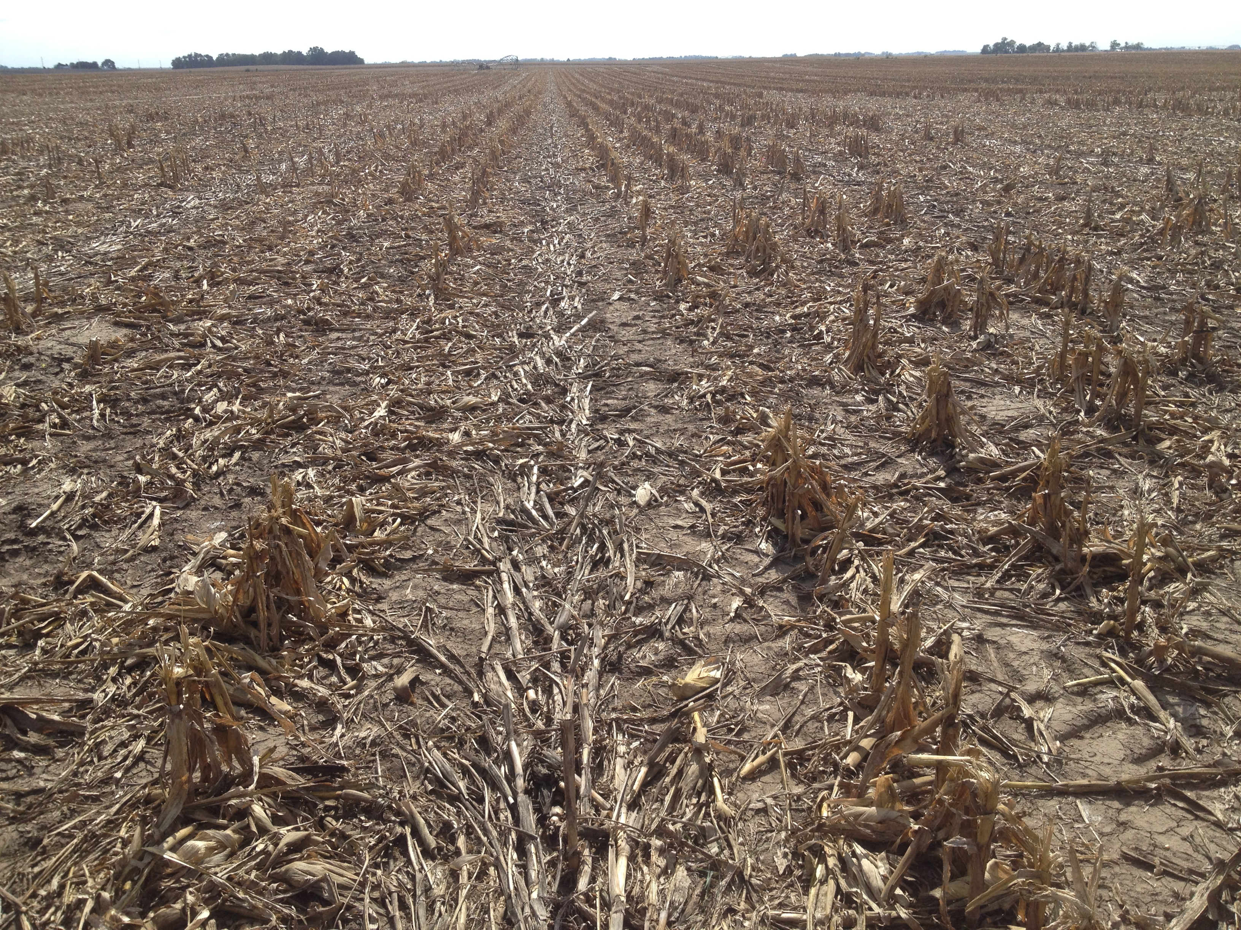
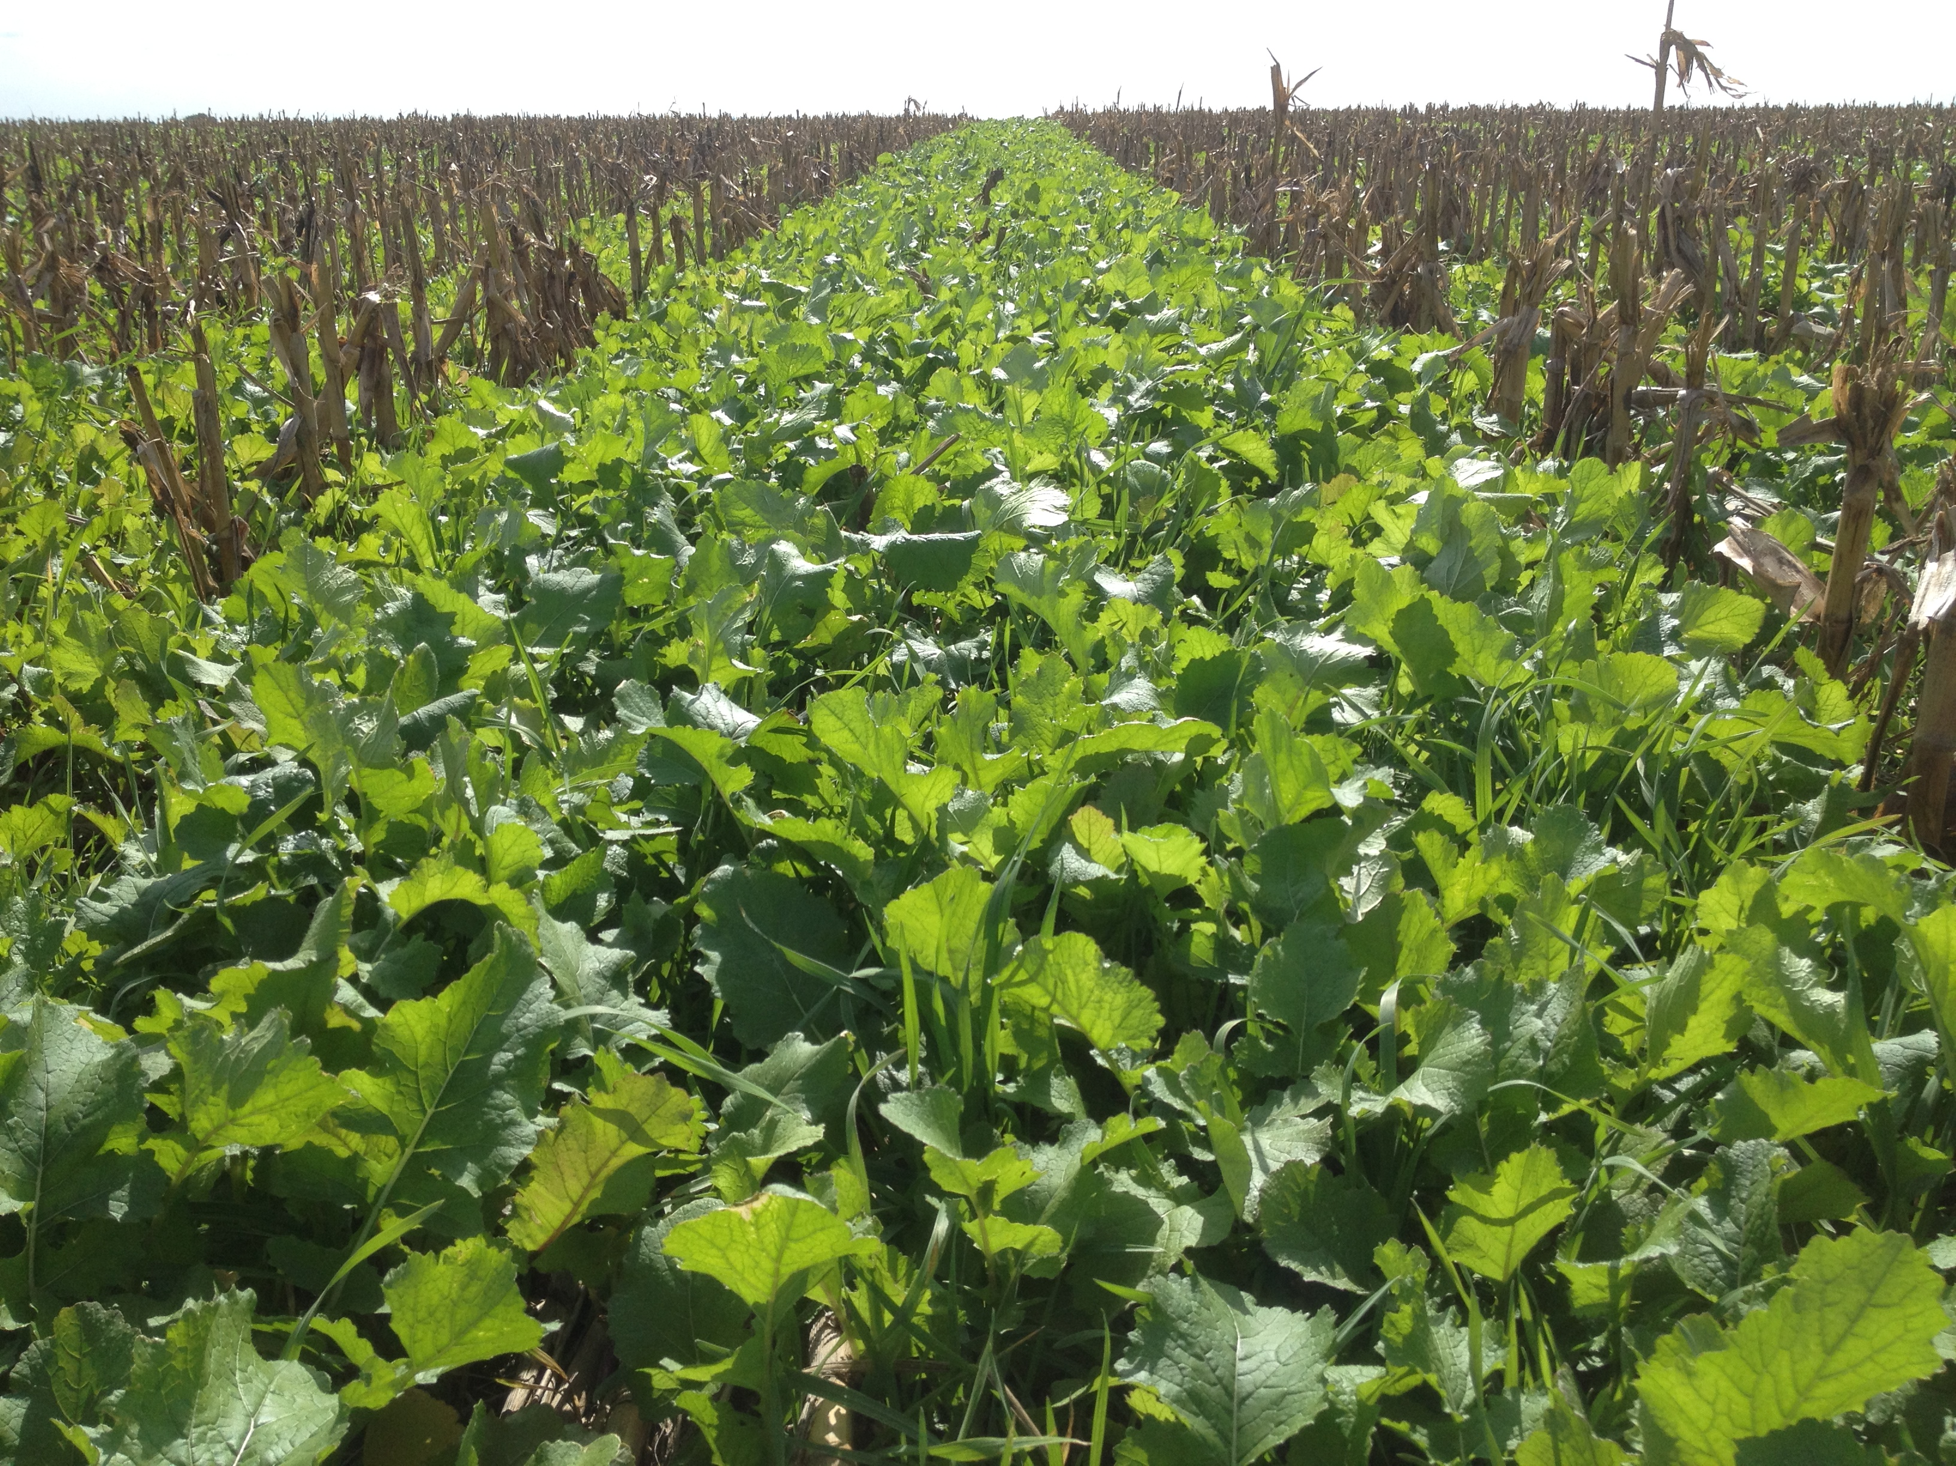
4. Resiliency (Weather and Soil Health)

Slide 18
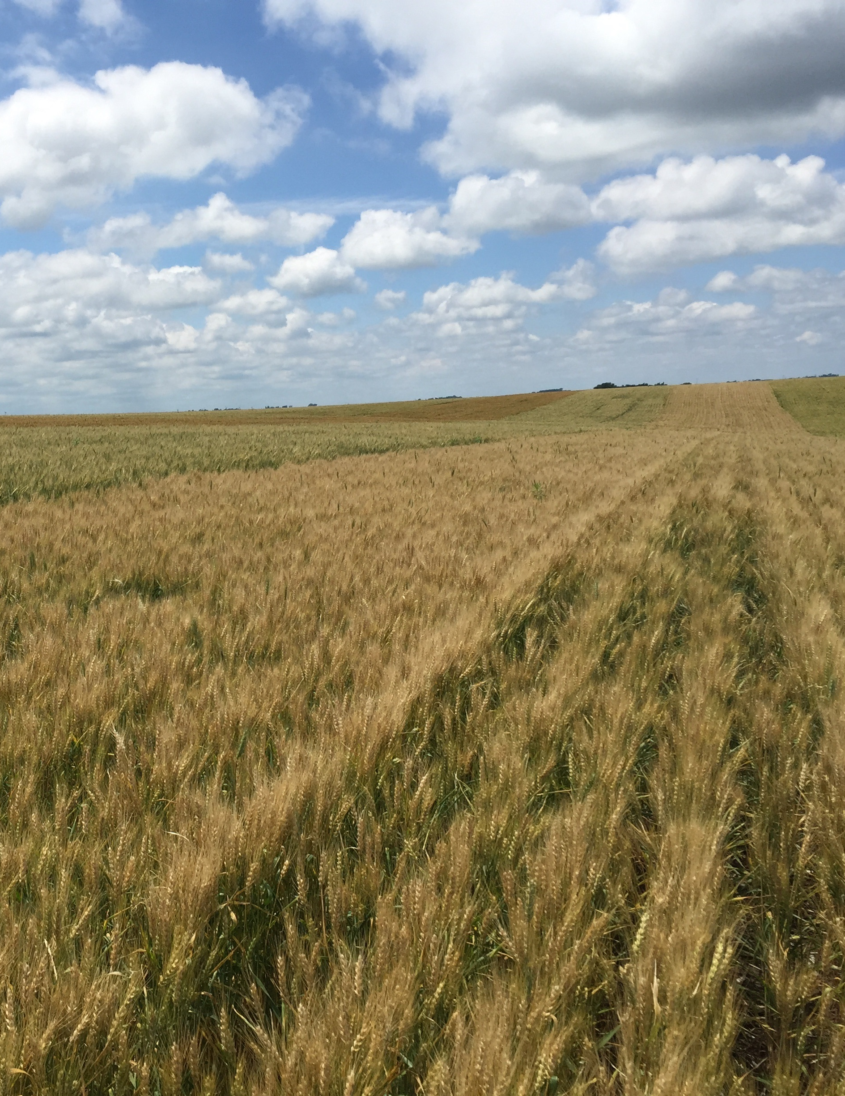
Winter Wheat Can Help
Intro About Wheat Economics Resiliency Growth & Development Management
Manure management flexibility
Consider all potential profits streams
Value of straw
Double crop and forages crop options
Potential nitrogen credit for legume cover crop
Corn and soybean yield improvement in 3-yr rotation
EQIP and CSP opportunities
Weed control & herbicide cost
Marestail, Palmer Amaranth, & Waterhemp
Soil health and conservation
Soil structure, erosion control, cost-share and priority
Workload management
Manage weather risks

Slide 19
Managing Risks from Extreme Weather
Intro About Wheat Economics Resiliency Growth & Development Management
Seasonal crop water use (ET) in Eastern Nebraska when water is not limiting.
Crop | Inches/year
Corn | 21-24
Soybean | 20-22
Winter Wheat | 16-18
Alfalfa | 31-35
Source: water.unl.edu
Source: Crop Water Use Curves from Colorado State University http://extension.colostate.edu/topic-areas/agriculture/limited-irrigation-managementprinciples-and-practices-4-720/

Slide 20
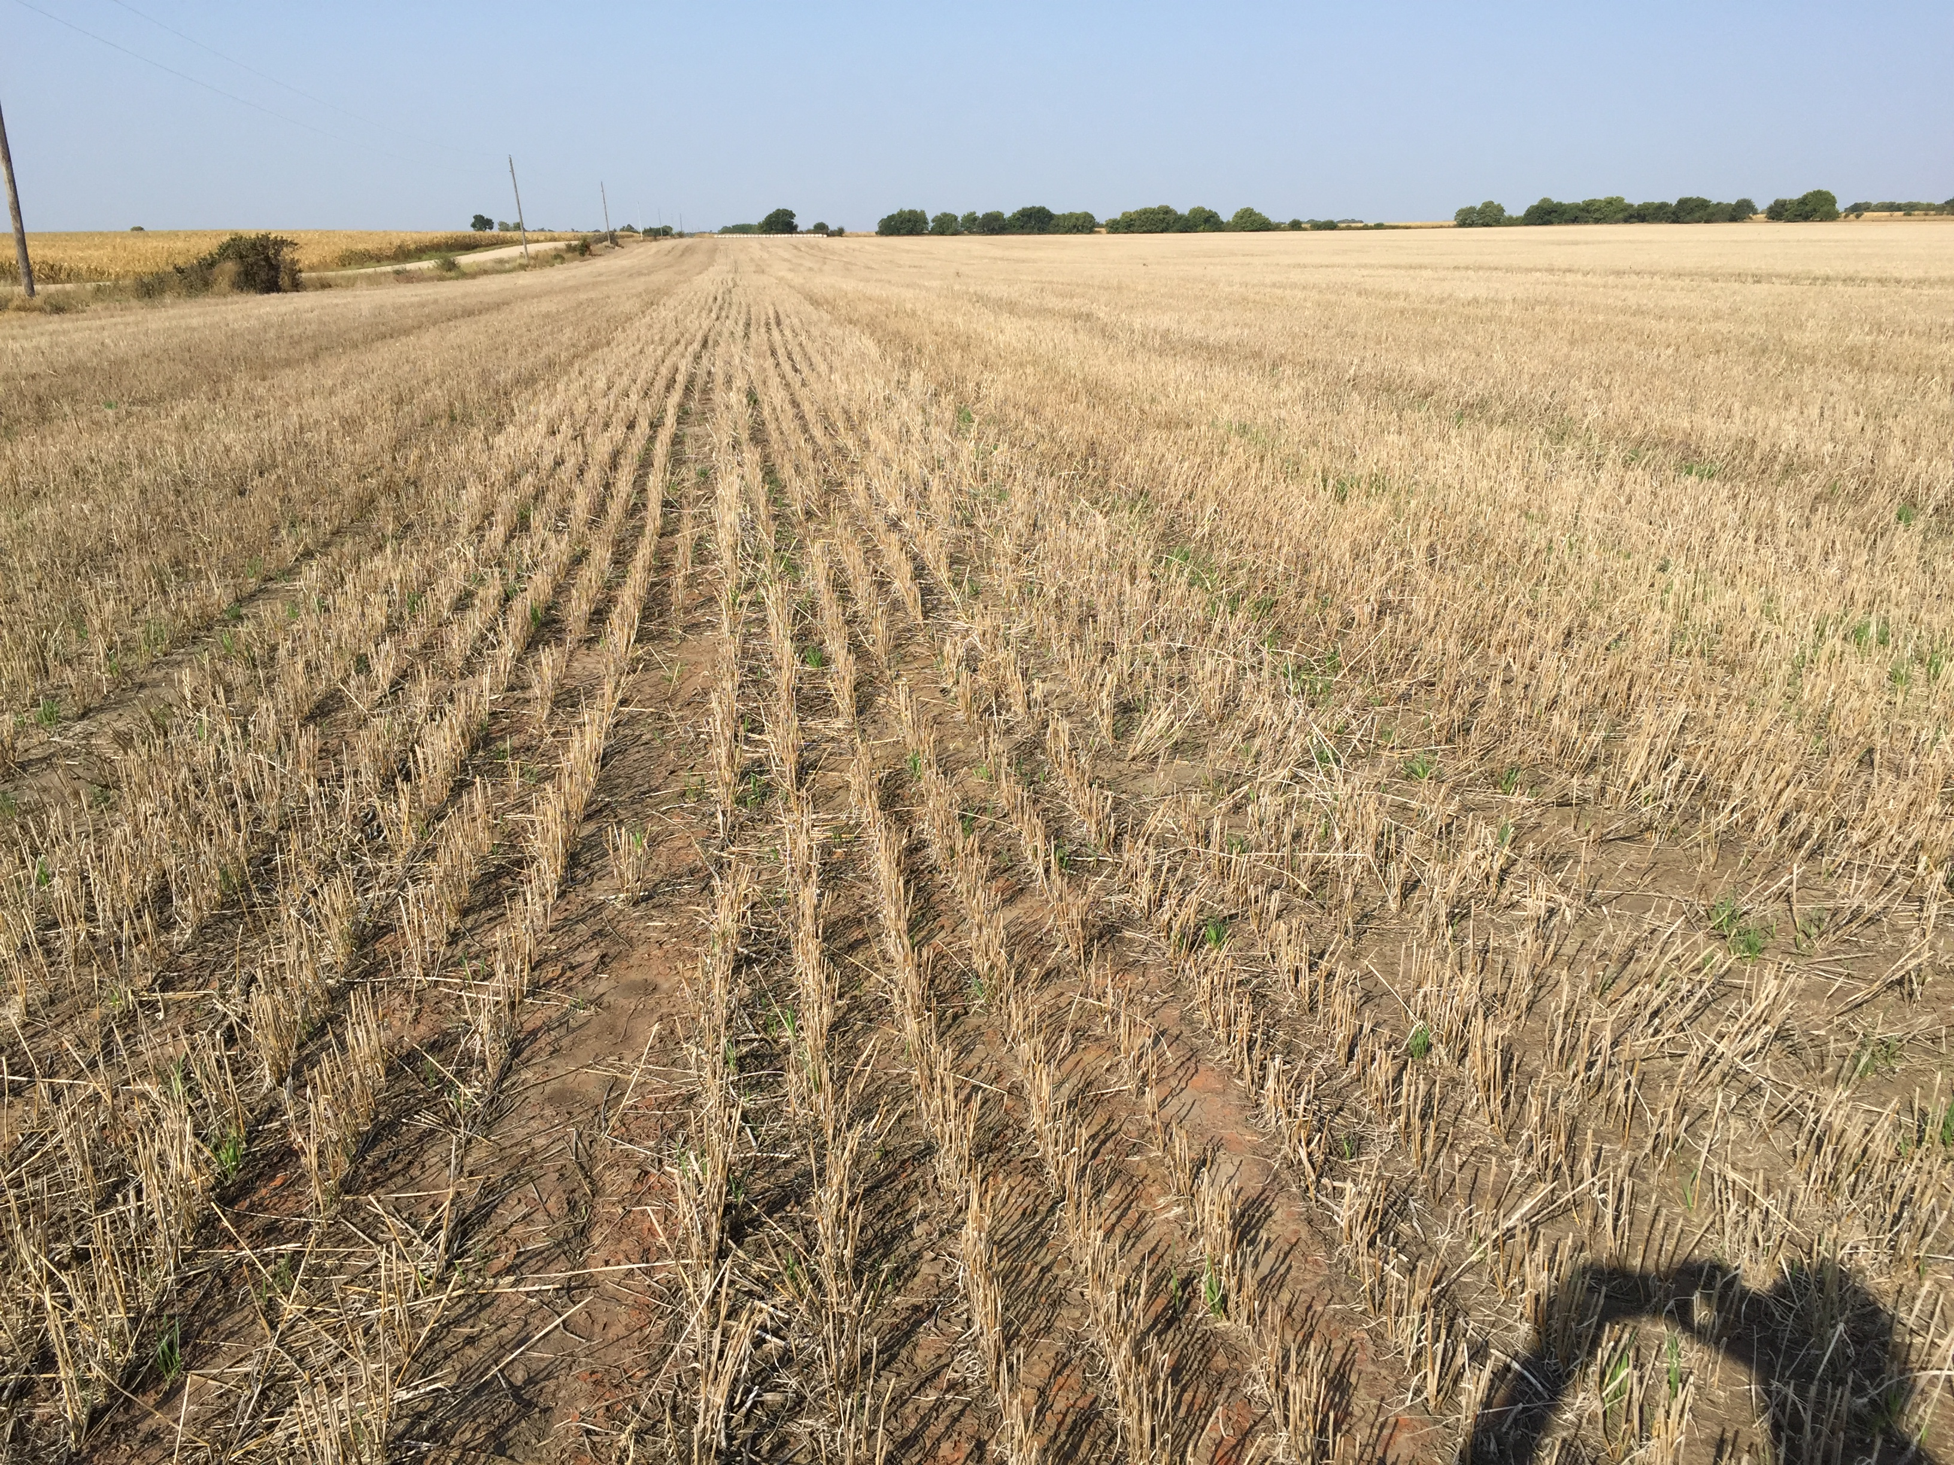
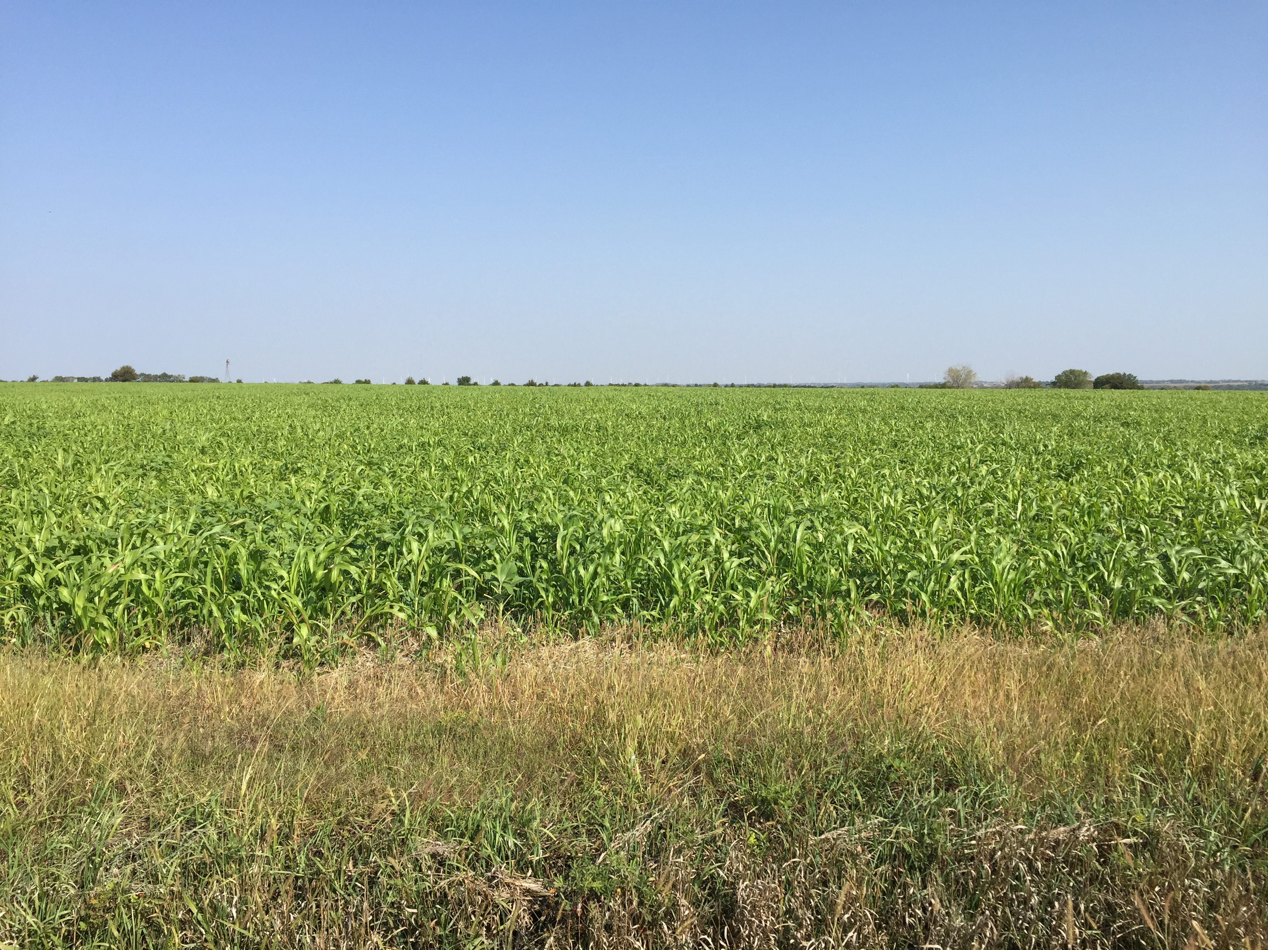
NRCS Four Principles of Soil Health
Use plant diversity to increase diversity in the soil
Manage soils more by disturbing them less
Keep the live root throughout the year to feed the soil
Keep the soils covered

Slide 21
Four Components of Crop Diversity
Working with Dwayne Beck
Years separating the same type of crop
Utilizing both grass and broadleaf crops
Having both spring and fall planted crops
Presence of warm and cool-season crops
Which of these components are we missing in a corn-soybean rotation?

Slide 22
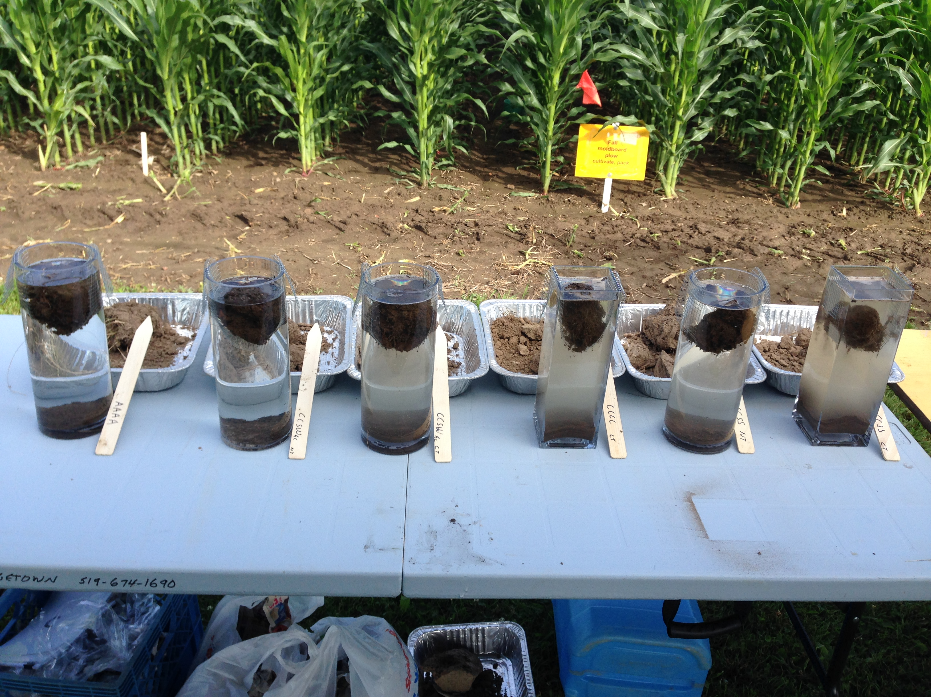
Intro About Wheat Economics Resiliency Growth & Development Management
Slake Test: Proxy for water stable aggregates
Alfalfa
CCSW(rc)-CT
CCSS-NT
CCSW(rc)-NT
CCCC-CT
CCSS-CT
Photo Credit: Bill Deen, University of Guelph

Slide 23
Water Stable Aggregates
Intro About Wheat Economics Resiliency Growth & Development Management
ab
b
Agronomy Journal 107:971-978 (2015) – Monmouth and Perry, IL

Slide 24
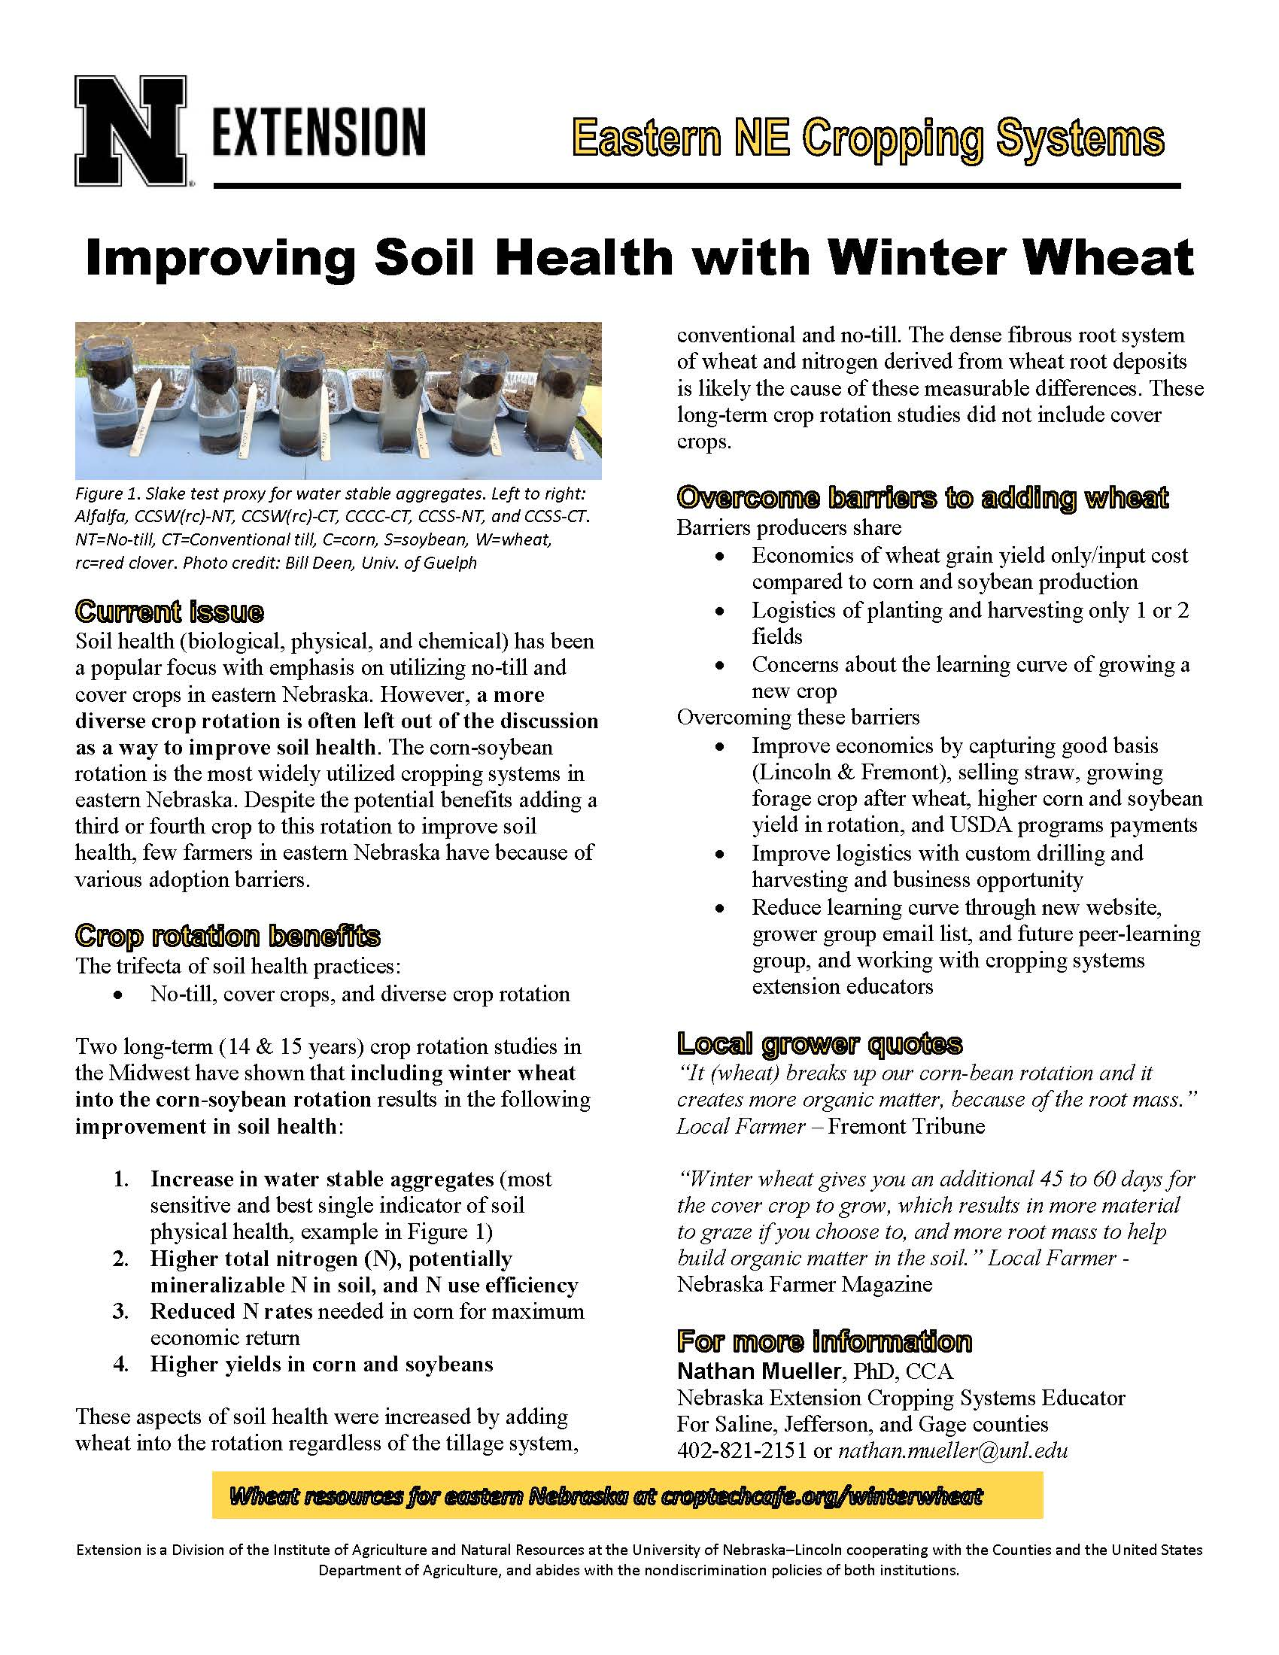
Improving Soil Health with Winter Wheat
Intro About Wheat Economics Resiliency Growth & Development Management
Aspects of soil health
Physical
Biological
Chemical
View at croptechcafe.org/winterwheat

Slide 25
5. Winter Wheat Development and Growth

Slide 26
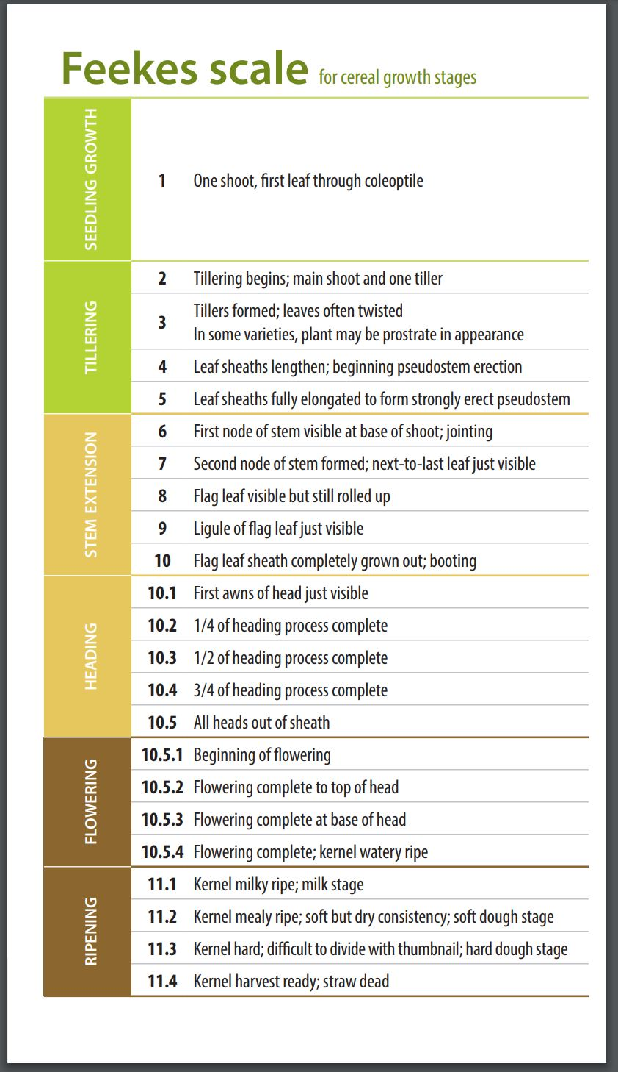
Wheat Development and Growth
Intro About Wheat Economics Resiliency Growth & Development Management
Feekes 2 & 3
Feekes 6
Feekes 9
Feekes 10.5.1
http://coolbean.info/wp-content/uploads/sites/3/2018/04/2018_WheatGrowthStages_FINAL.pdf

Slide 27
6a. Winter Wheat Management

Slide 28
Best Management Practice (BMPs) of Winter Wheat Production
Intro About Wheat Economics Resiliency Growth & Development Management
Rank | Management Factor | Yield Difference (bu/ac)
1 | Variety Selection | 10 - 20
2 | Foliar Fungicide | 10 - 16
3 | Planting Date (2 wks) | 10
4 | Nutrient Management | 7
5 | Seeding Rate | 5
Yields difference not all additive due to interactions

Slide 29
6a. Variety Selection

Slide 30
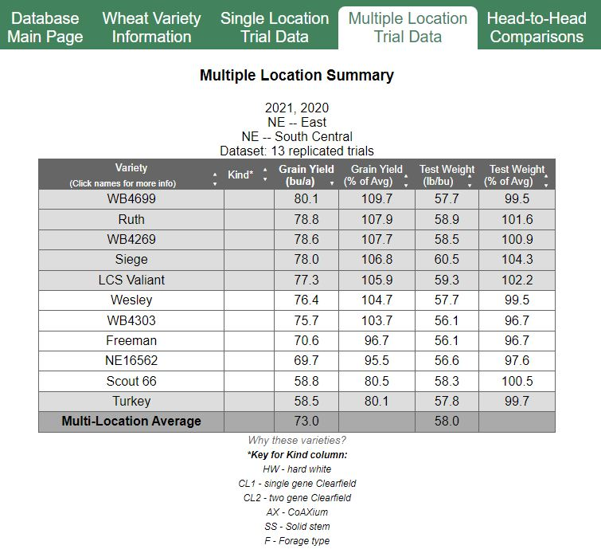
Variety Selection
Intro About Wheat Economics Resiliency Growth & Development Management
Wheat Variety Comparison Database
http://ramwheatdb.com/database.php
UNL Variety Trial Test Results
http://cropwatch.unl.edu/winter-wheat-variety-test-results
Wheat Variety App (NEW) https://cropwatch.unl.edu/wheat-variety-app

Slide 31
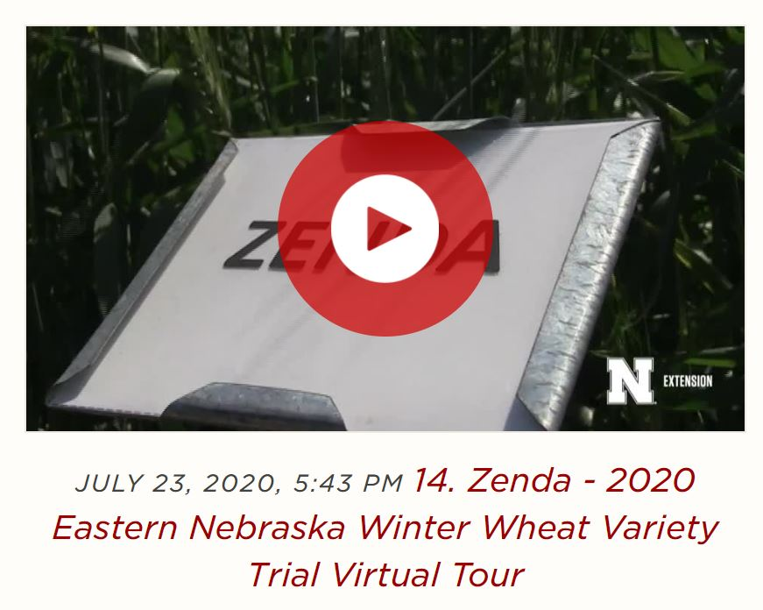
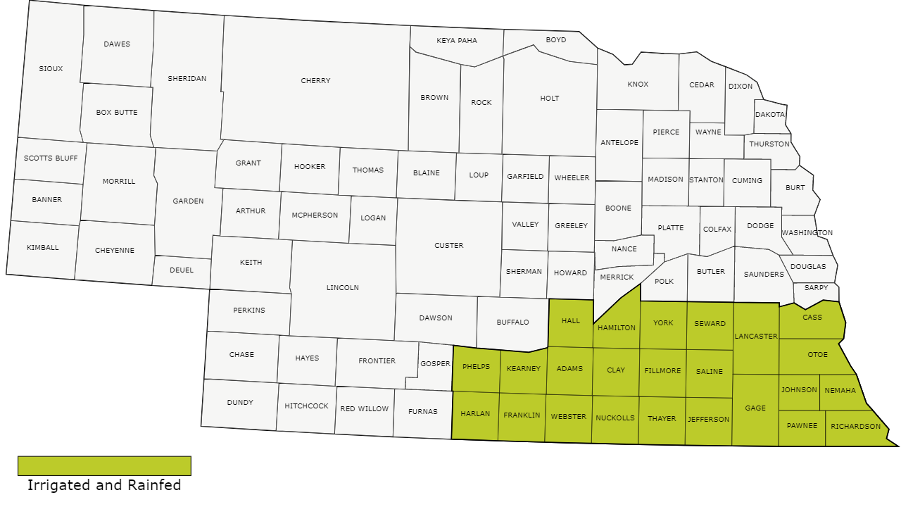
Example: Zenda – Kansas Wheat Alliance Released 2016
Intro About Wheat Economics Resiliency Growth & Development Management
Placement
Southeast & south central NE
Highlights
Great yield performance record in UNL 3-yr trials
Moderate resistance to Fusarium Head Blight
Excellent test weight
Management Suggestions
Replacement for Everest
Average drought tolerance
View at croptechcafe.org/winterwheat

Slide 32
6b. Disease Management

Slide 33
Disease Triangle – Leaf Rust (Puccinia triticina)
Intro About Wheat Economics Resiliency Growth & Development Management
Susceptible Wheat Variety
Environmental Conditions (59-68°F plus 6 hours of leaf wetness for infection & 68-77°F plus wet weather)
Yield loss of
10-20%
Environmental Conditions
Pathogen
Moderately Resistant Wheat Variety
Pathogen
Timing of environmental conditions

Slide 34
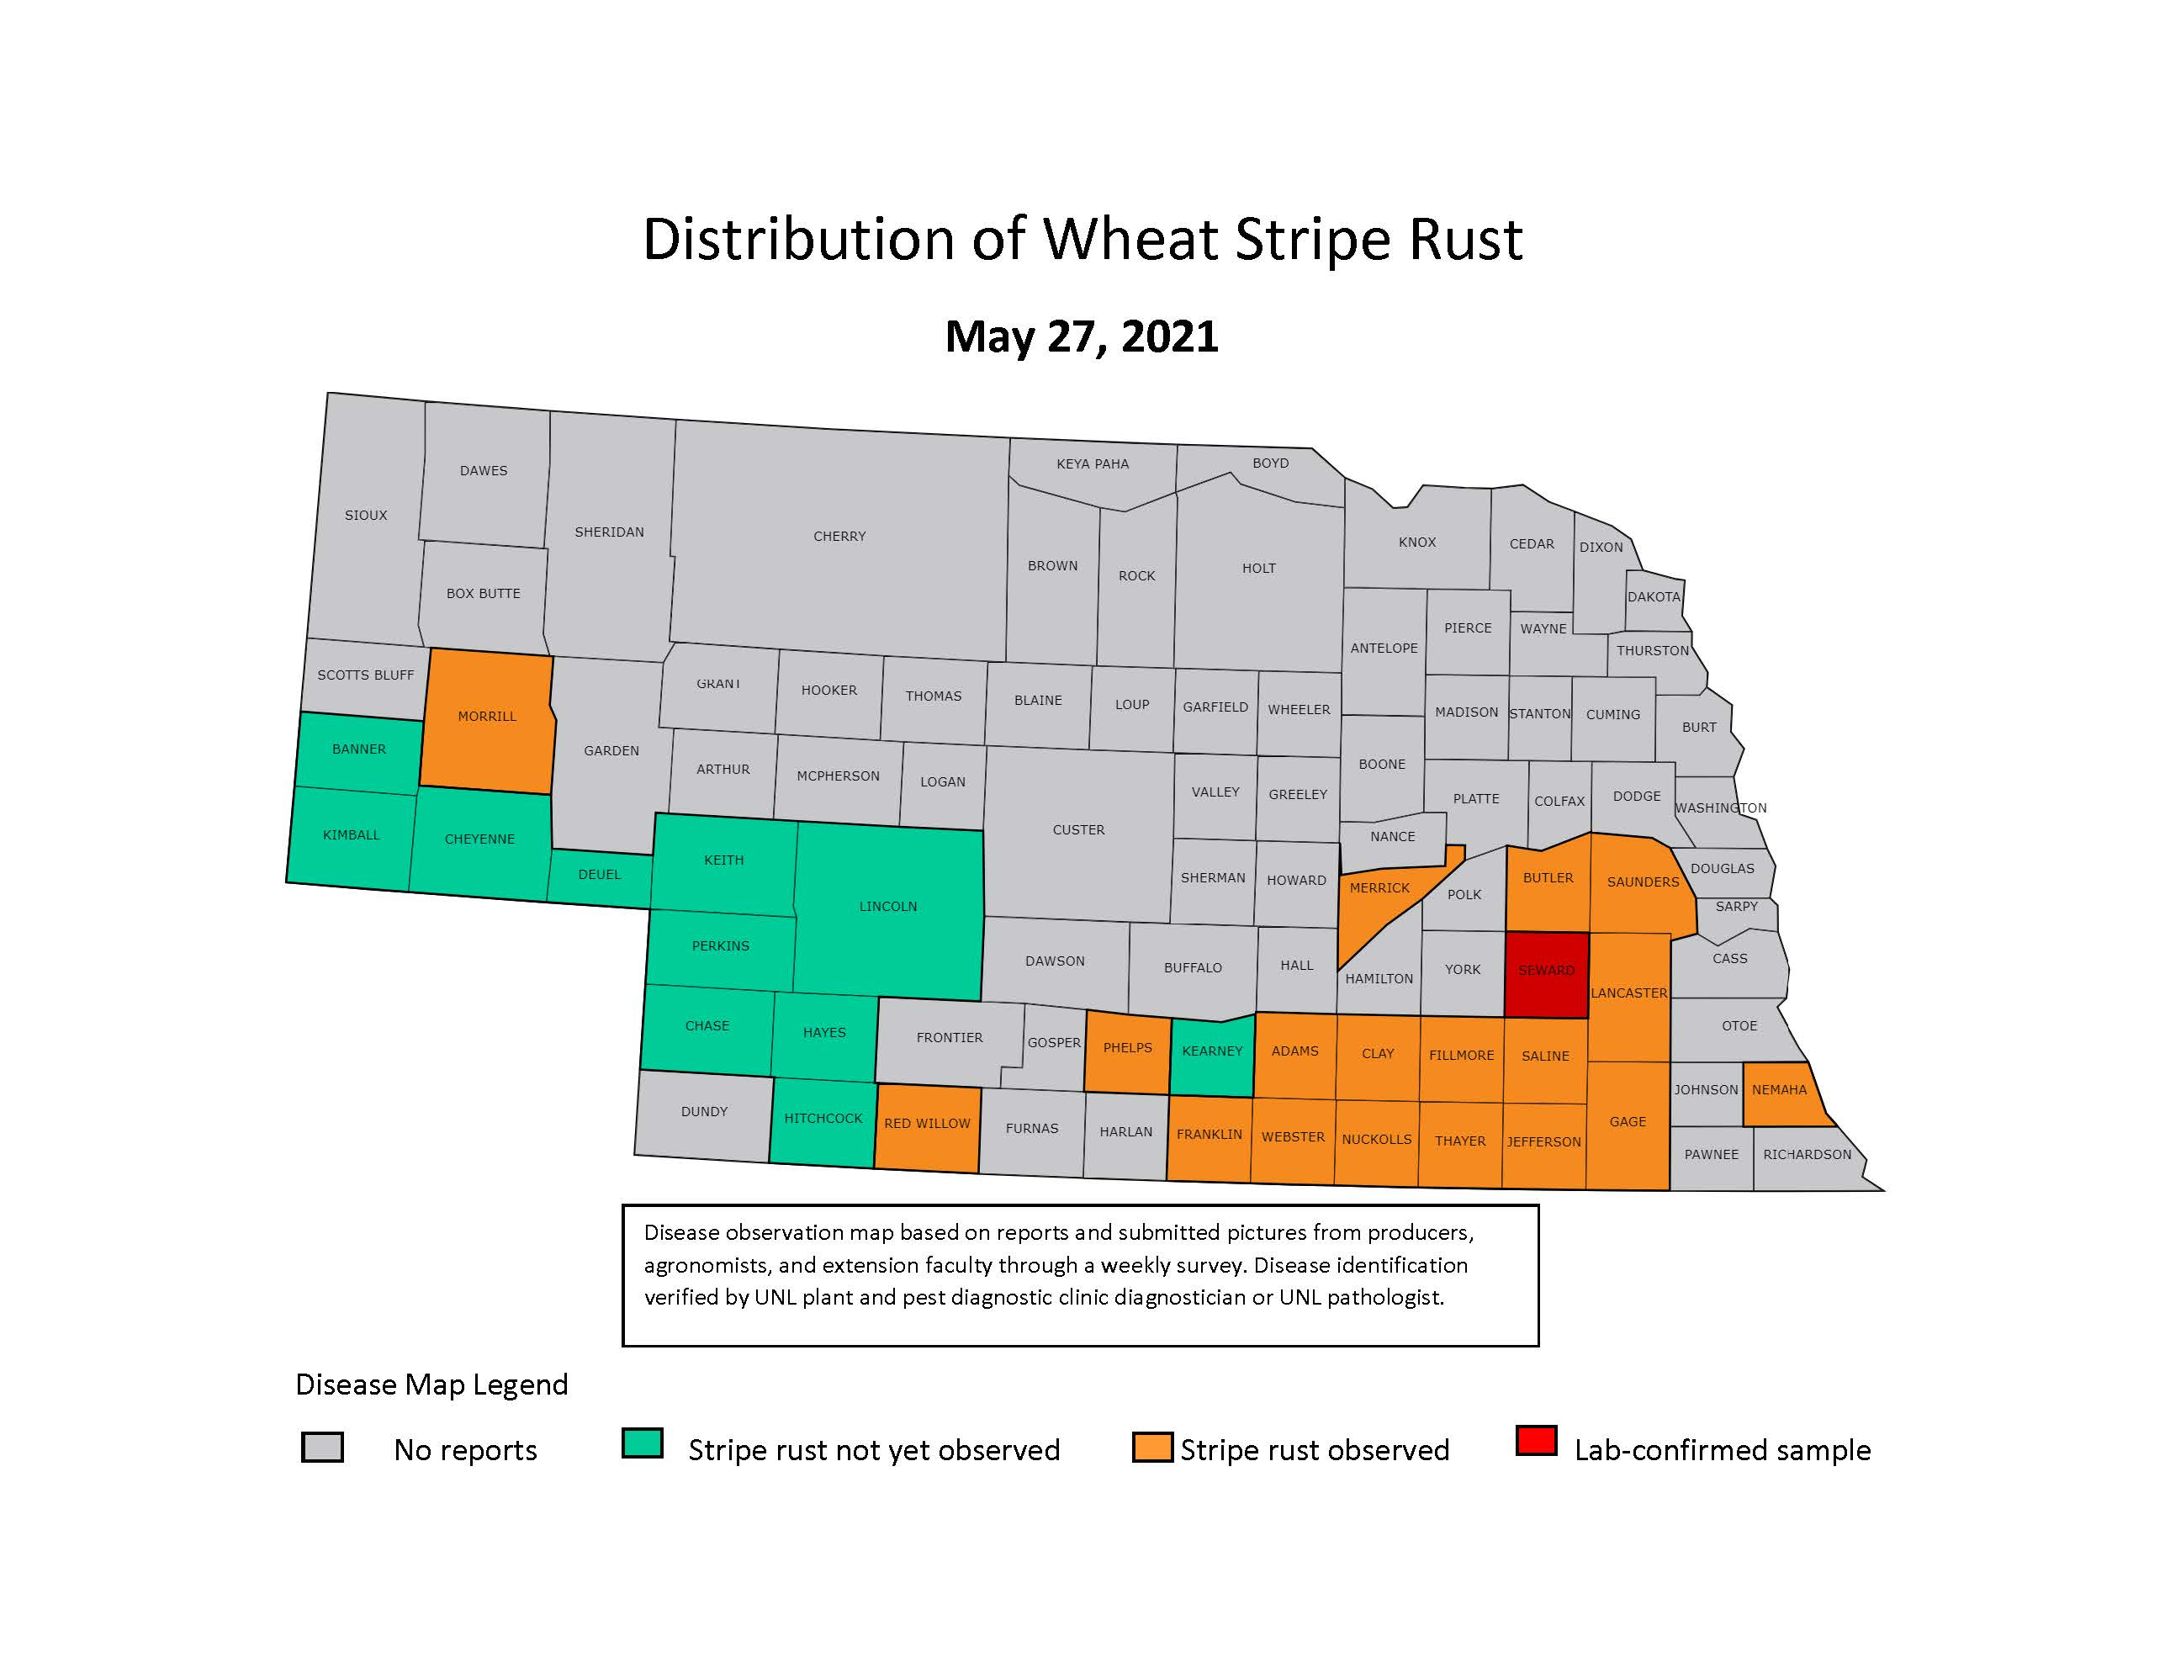
Leaf and Stripe Rust Tracking Map
Intro About Wheat Economics Resiliency Growth & Development Management
View at cropwatch.unl.edu/plantdisease/wheat

Slide 35
Leaf Rust
Intro About Wheat Economics Resiliency Growth & Development Management
Disease
Caused by fungus Puccinia triticina
Does not overwinter
Central and eastern Nebraska
Yield losses up to 14% typical
Management
Variety selection for resistance
Scouting
Foliar fungicide

Slide 36
Stripe Rust
Intro About Wheat Economics Resiliency Growth & Development Management
Disease
Caused by fungus Puccinia striiformis f. sp. Tritica
Does not overwinter
Has become a significant disease since 2010 in Nebraska
Yield loss up to 40%
Management
Variety selection for resistance
Scouting
Foliar fungicide

Slide 37
Foliar Fungicide at Flag Leaf
Intro About Wheat Economics Resiliency Growth & Development Management
a
b
9 bu/ac
a
12 bu/ac
b
Bhatta, M. 2015. Effect of genotype, environment, and production packages on yield, agronomic characteristics, and end-use quality of winter wheat. Master’s thesis, Univ. of Nebraska, Lincoln, NE. http://digitalcommons.unl.edu/agronhortdiss/98.

Slide 38
Fusarium Head Blight (Scab)
Intro About Wheat Economics Resiliency Growth & Development Management
Disease
Caused by fungus Fusarium graminearum & boothii
Reported in NE since 1898
Survives on residue, in soil
Rainfall/humidity during flowering
Vomitoxin (DON)
Management
After corn is the highest risk
Variety selection for resistance
Disease risk mapping (http://www.wheatscab.psu.edu/)
Scouting
Foliar fungicide at early flowering

Slide 39
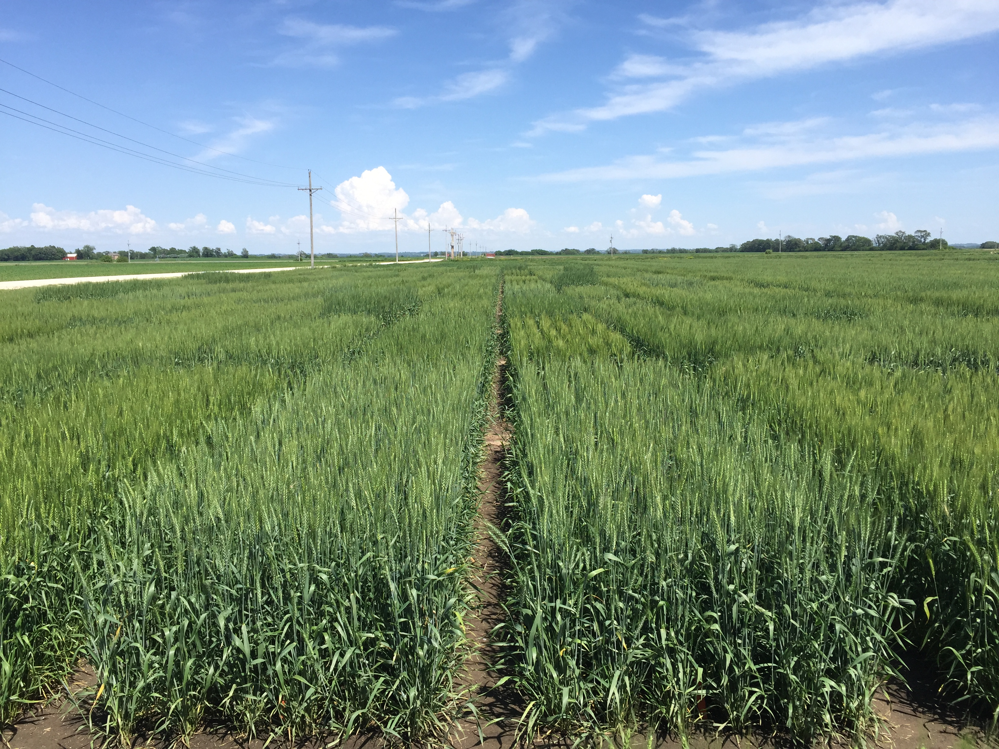
Varieties with Moderate Resistance for FHB
Intro About Wheat Economics Resiliency Growth & Development Management
Utilize Disease Ratings
Ratings of 4 to 5
Varieties in East NE
WB4699 (4)
Zenda (4)
WB4269 (5)
WB4401 (5)
LCS Valiant (5-6)

Slide 40
Stage of Development for FHB
Intro About Wheat Economics Resiliency Growth & Development Management

Slide 41
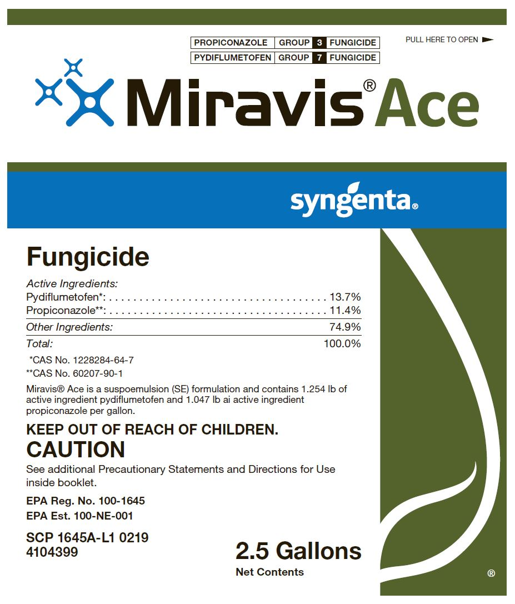
Fungicides for FHB
Intro About Wheat Economics Resiliency Growth & Development Management
Prosaro 421 SC from Bayer
Prothioconazole (3, Triazole)
Tebuconazole (3)
Prosaro Pro 400 SC - NEW
Prothioconazole (3)
Tebuconazole (3)
Fluopyram (7, SDHI)
Caramba from BASF
Metconazole (3)
Miravis Ace from Syngenta
Propiconazole (3)
Pydiflumetofen (7)

Slide 42
6c. Planting Date and Seeding Rate

Slide 43
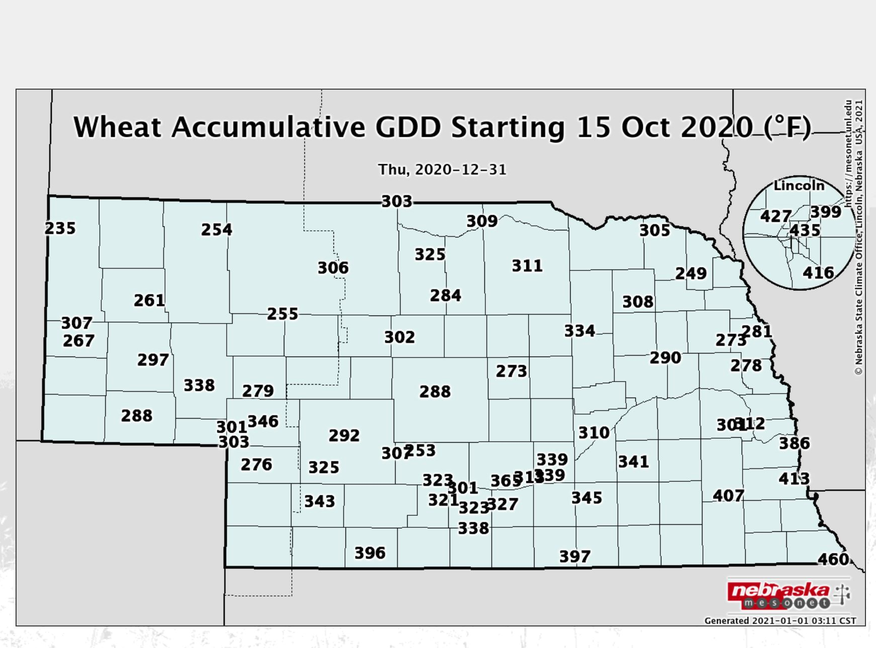
Target Planting Date Map
Intro About Wheat Economics Resiliency Growth & Development Management
400 GDD (Base 40) accumulation between planting and December 31
1980s work in southeast NE
Temperature norms – 1981-2010
October 1
October 5
Daily accumulated GDD map: https://mesonet.unl.edu/
October 10
Oct. 15

Slide 44
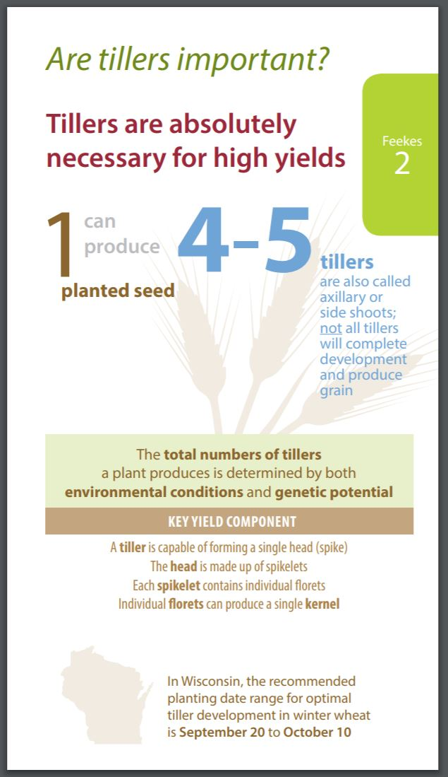
Wheat Development and Growth
Intro About Wheat Economics Resiliency Growth & Development Management
http://coolbean.info/wp-content/uploads/sites/3/2018/04/2018_WheatGrowthStages_FINAL.pdf

Slide 45
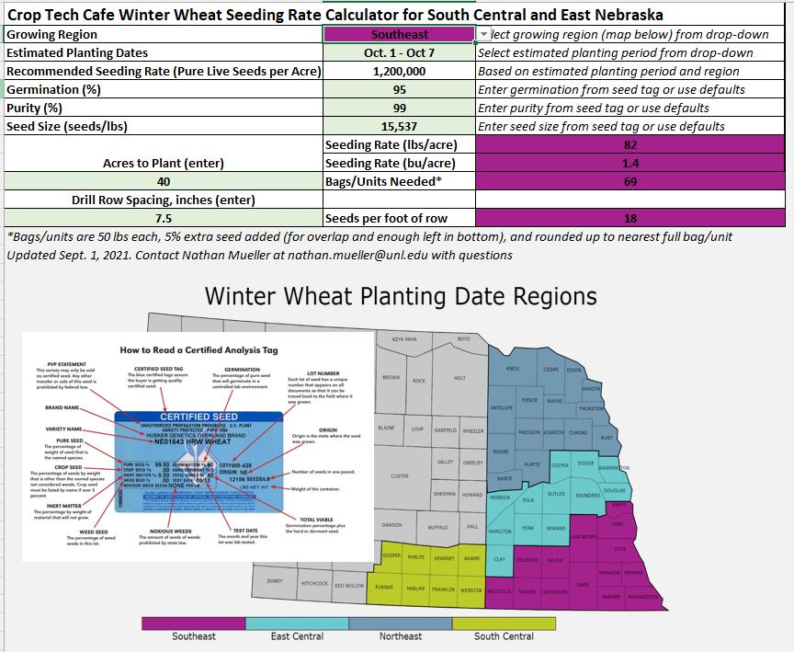
Seeding Rate and Planting Date
Intro About Wheat Economics Resiliency Growth & Development Management
Download at croptechcafe.org/winterwheat

Slide 46
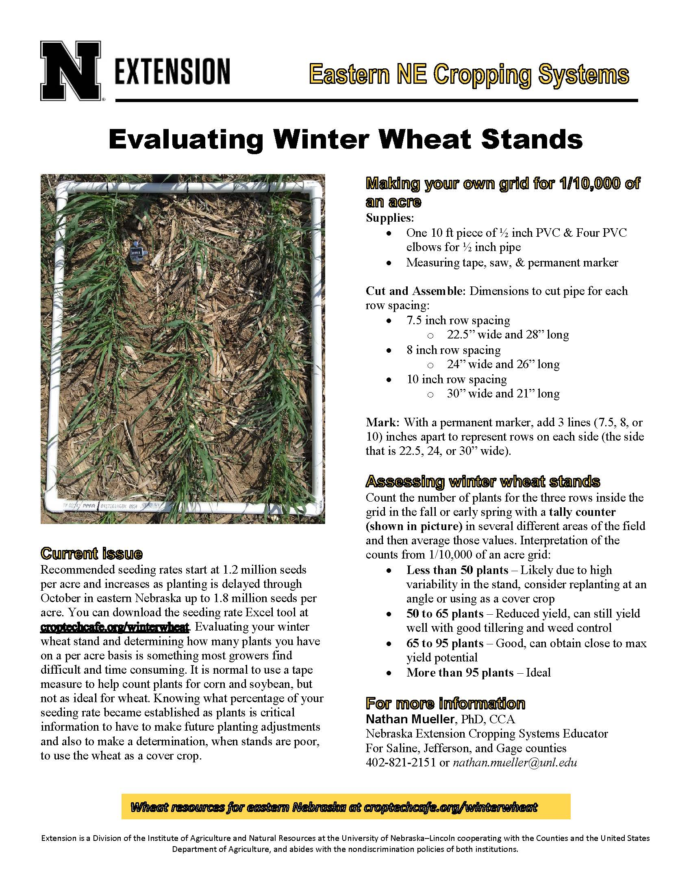
Evaluating Winter Wheat Stands
Intro About Wheat Economics Resiliency Growth & Development Management
Better option than a tape measure
No need to glue together, so easy storage.
Interpretations
Assesses yield components
Risk of weed pressure
View at croptechcafe.org/winterwheat

Slide 47
6d. Nutrient Management
N P K S Ca Mg
Fe Mn Cu Zn B Cl Mo Ni

Slide 48
Nitrogen Management
Intro About Wheat Economics Resiliency Growth & Development Management
Based on regional UNL recommendations and local grower experiences
80 – 120 lbs N/acre
Apply most or all as wheat begins to green up in February/March
Grain protein may be improved with late N applications
N at Flag leaf can still improved protein/yield
N

Slide 49
Phosphorus Management
Intro About Wheat Economics Resiliency Growth & Development Management
Higher soil test phosphorus needed compared to corn and soybeans
Similar to alfalfa and corn-after-corn
25 ppm Bray P1 or more
Helps with early growth, tillering, and winter hardiness
P

Slide 50
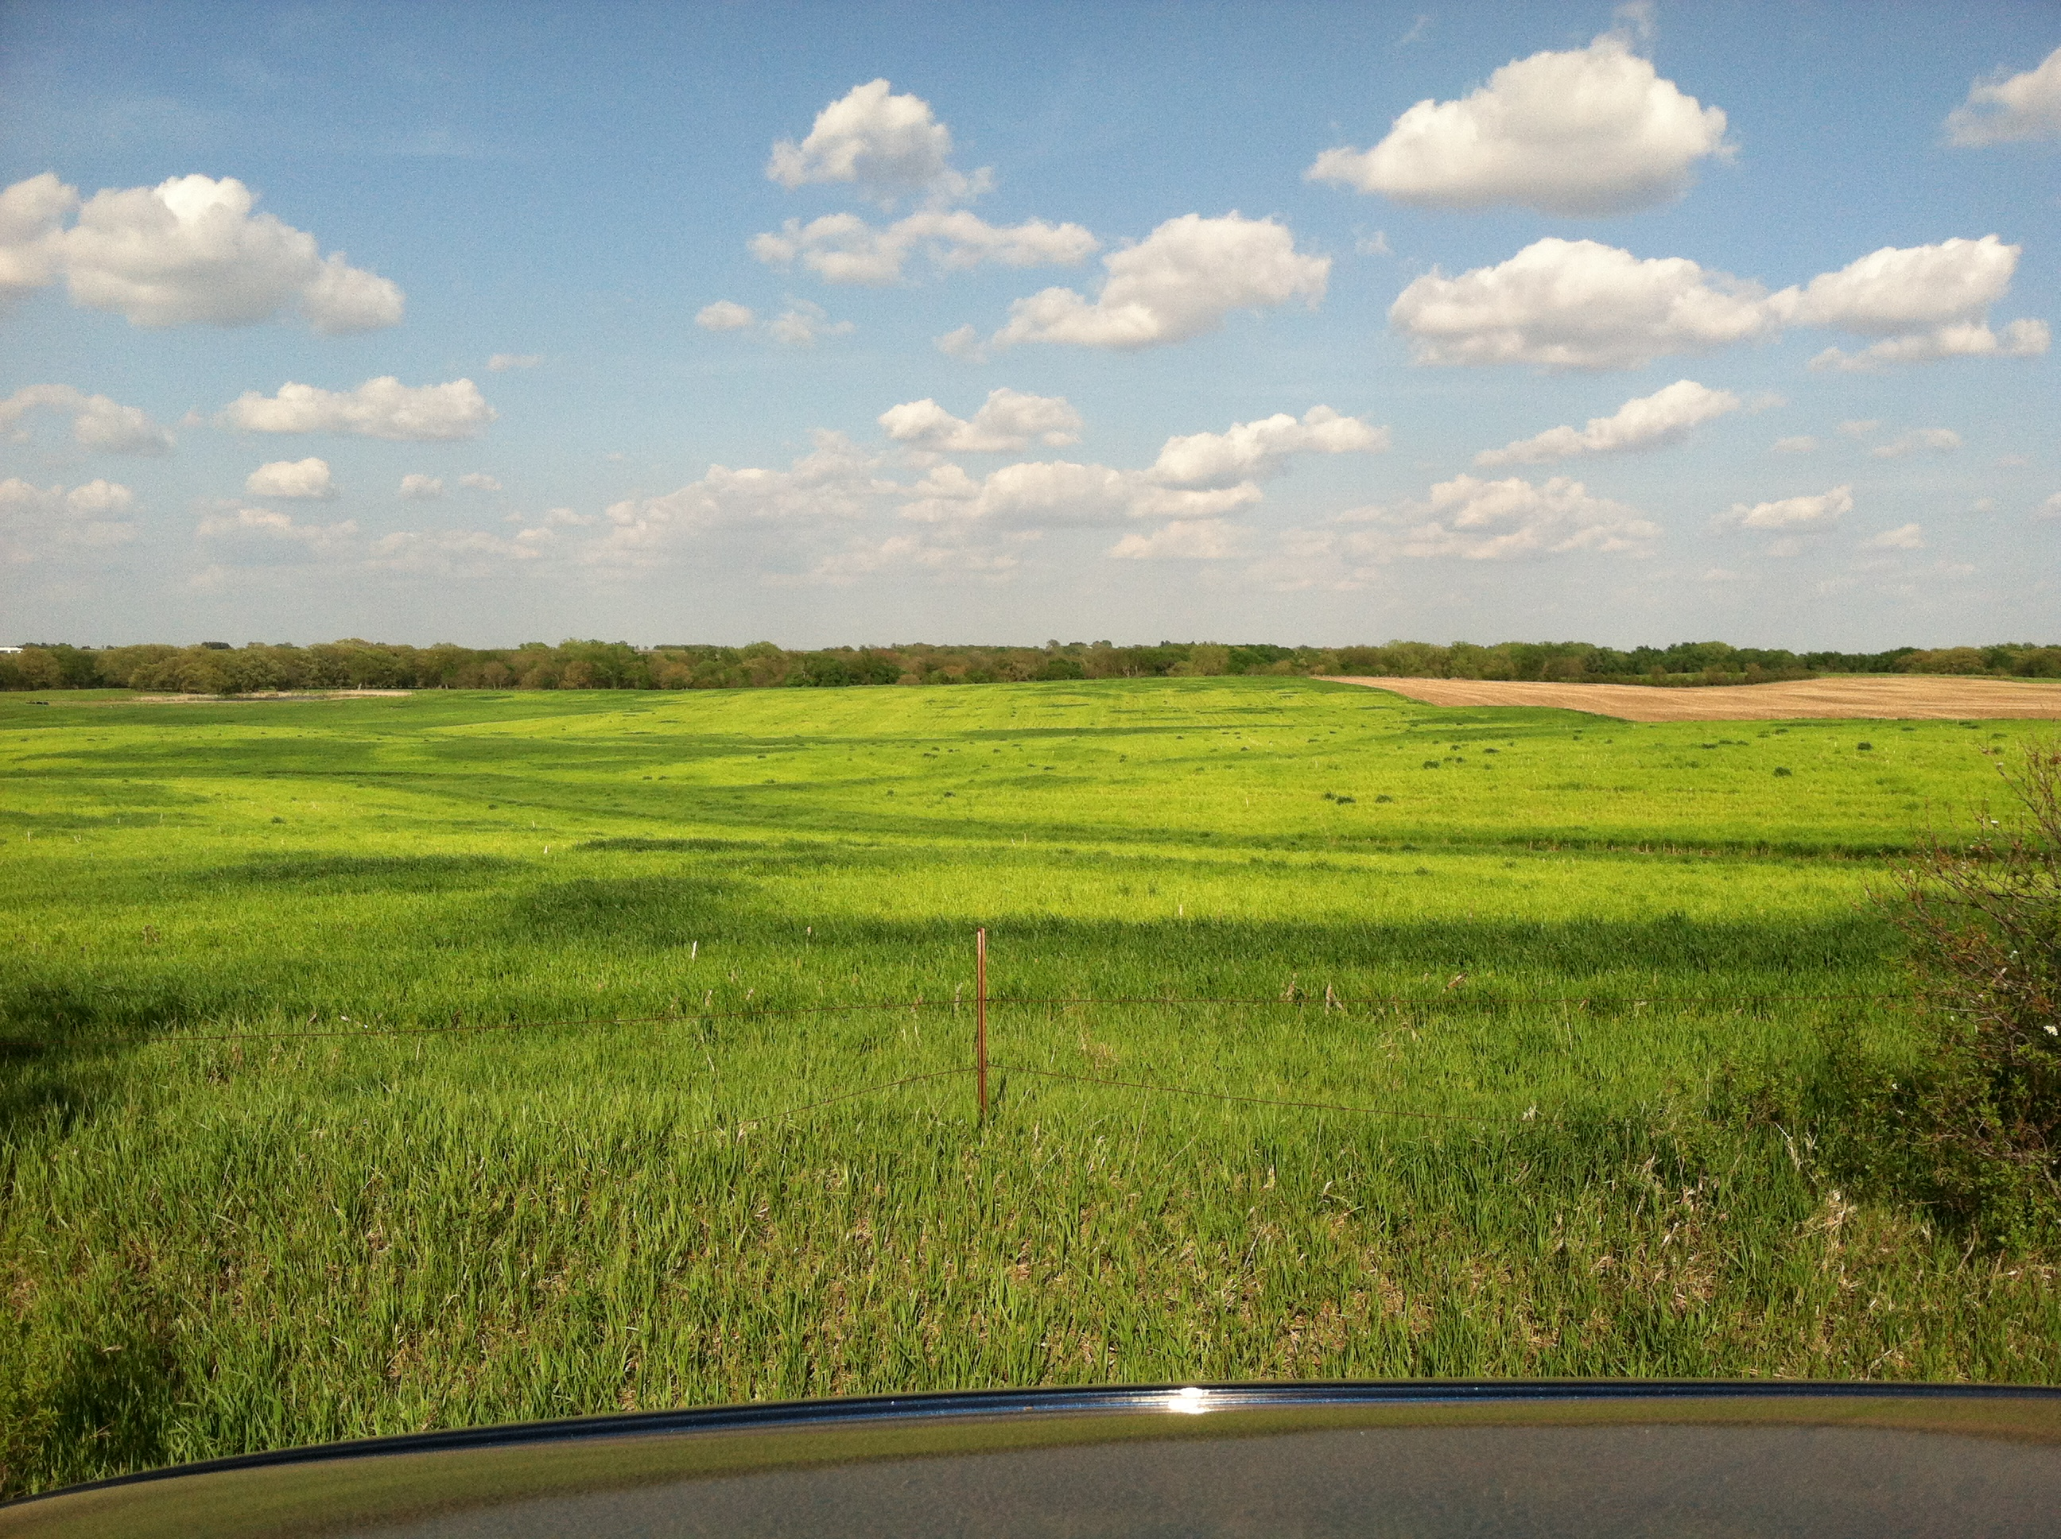
Sulfur and Chloride Management in Winter Wheat
Intro About Wheat Economics Resiliency Growth & Development Management
S
Cl
Crop Tech Cafe article: http://croptechcafe.org/spring-chloride-and-sulfur-for-wheat/
Photo by Randy Pryor

Slide 51
Benefits of Crop Rotation: The Case for Adding Wheat
Intro About Wheat Economics Resiliency Growth & Development Management
Nathan Mueller, Ph.D., CCA
Water & Integrated Cropping Systems Extension Educator
Acct. Region: Saline, Jefferson, & Gage counties
nathan.mueller@unl.edu
@croptechcafe

