Slide 1
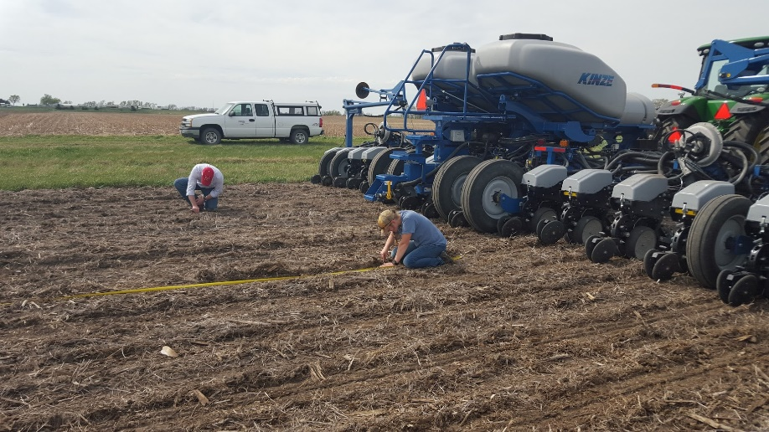
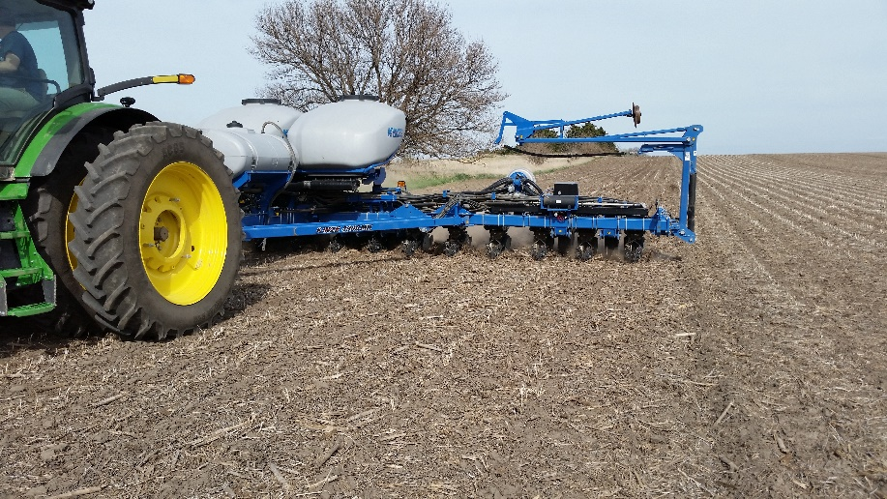
Multi-Hybrid Planting: Lessons Learned from On-Farm Trials, What Works and What Will it Pay?
Joe D. Luck, Rachel H. Stevens, Laura J. Thompson, J.T. Evans, and N.M. Mueller

Slide 2
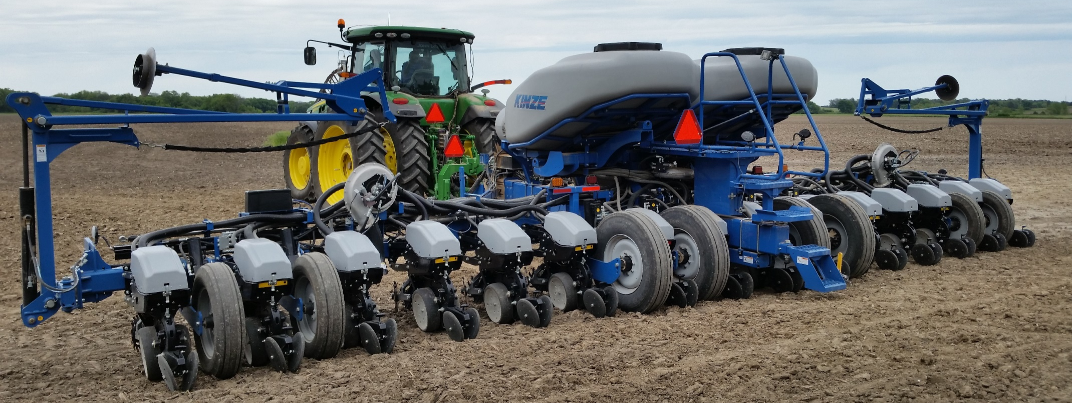
Discussion Topics
Two different hybrids (or treated/untreated seeds are placed in separate bulk tanks
Farm scale benchmarking…a case study using multi-hybrid planter technology in soybeans and corn
Making use of your data for benchmarking…on farm research trials
Dual seed meters switch on/off to drop seed from appropriate bulk tank

Slide 3
Farm Scale Production Benchmarking, a Case Study in Soybean Production… Multi-Hybrid Planter

Slide 4
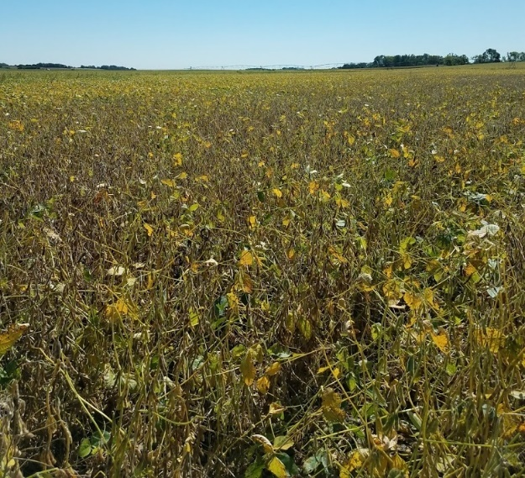
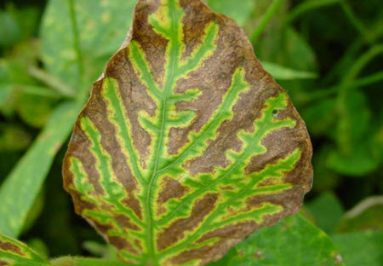
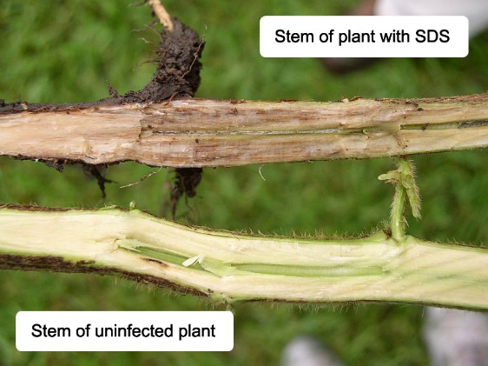
Multi-Hybrid Application for SDS Treatment
Sudden Death Syndrome – a soil borne disease affecting soybeans
Overwinters in the soil and residue, may be transported on equipment
Infection of plants occurs early in spring, cool, wet conditions favor development
Also favored in high yielding fields, irrigated sites, higher sand contents, lower pH and high P levels

Slide 5
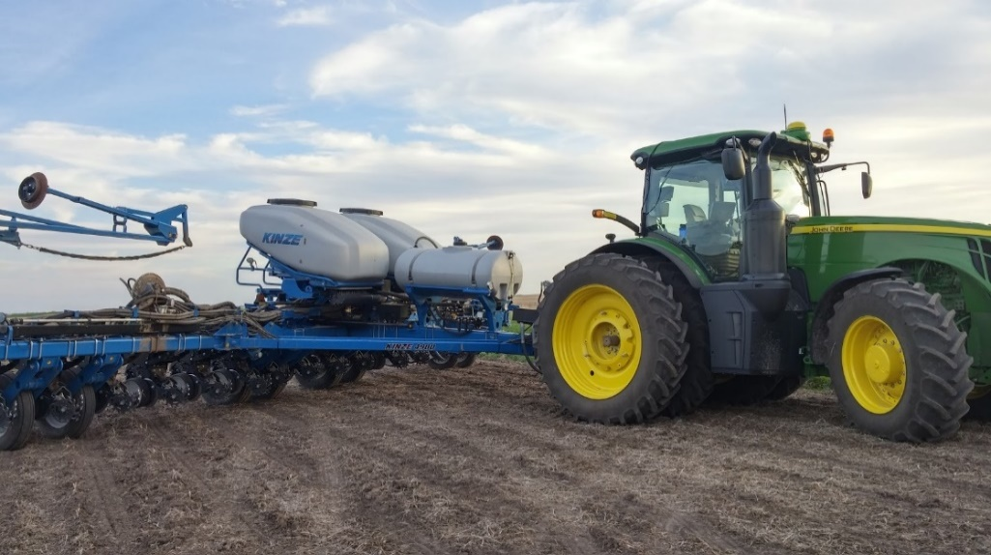
Multi-Hybrid Application for SDS Treatment
Goal was to assess non-treated (standard) and ILeVO seed treatments by zones based on previously collected yield data & grower knowledge and crop scouting
Zones were delineated for locations where SDS pressure was noticed which would receive ILeVO seed treatment
Kinze multi-hybrid planter was used to place treated versus non-treated seeds in prescribed locations
Treatment cost of ILeVO estimated at $15.17/ac

Slide 6
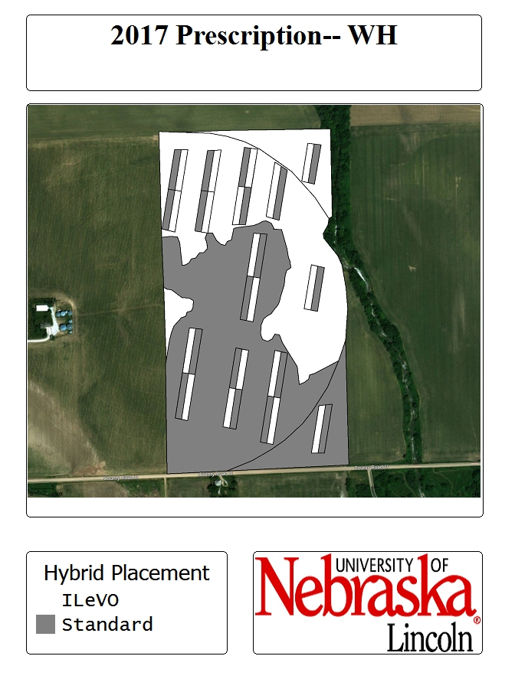
Multi-Hybrid Application for SDS Treatment
Historic yield maps were used for clustering
Ensure that the clusters most closely represented low yielding areas due to SDS (documentation by growers)
Processed in Management Zone Analyst
Varieties selected with excellent SDS disease resistance scores

Slide 7
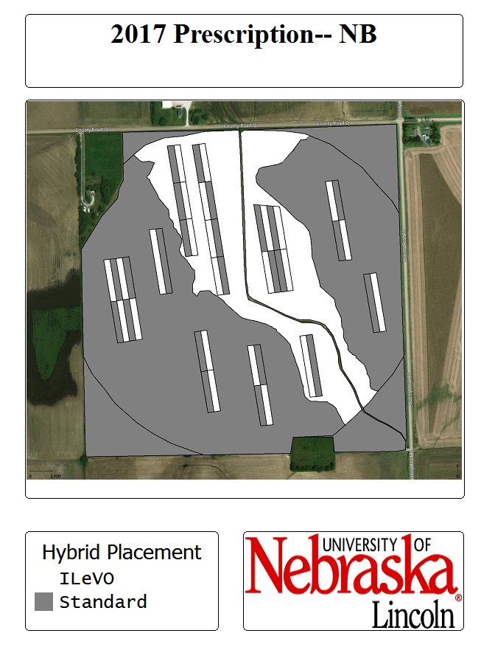
Multi-Hybrid Application for SDS Treatment
Notice 2 zones in prescription map:
“ILeVO” zone where historic SDS pressure was documented
“Standard” zone where SDS pressure had not been noticed
Randomized, replicated test strips were placed throughout both zones, allowing for future statistical comparison
Marginal Net Return (MNR) was calculated based on yield, price, and cost of ILeVO treatment

Slide 8
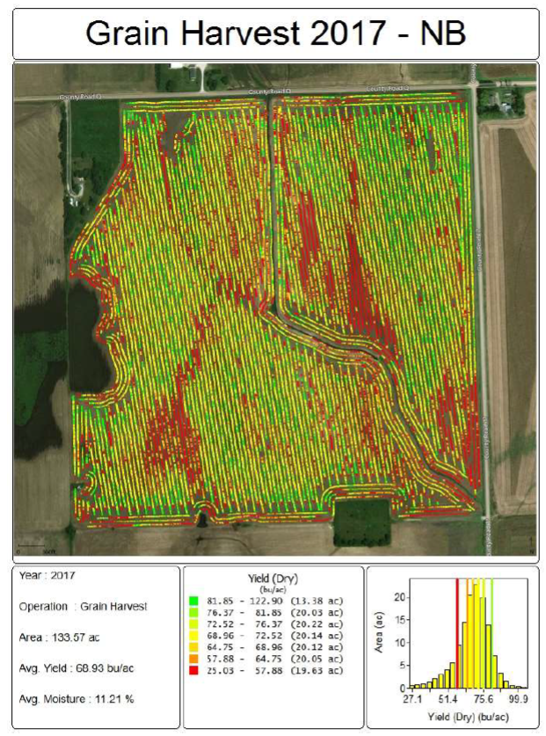
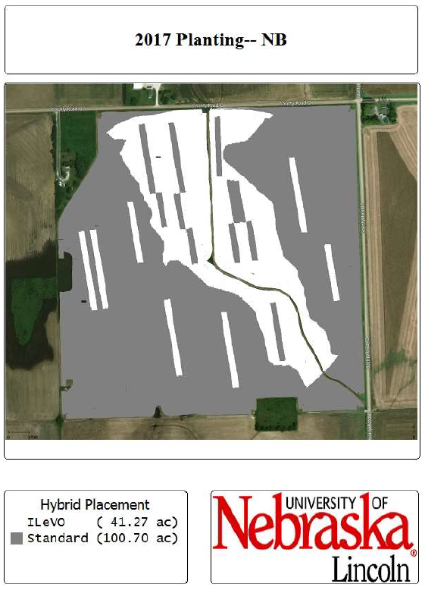
Multi-Hybrid Application for SDS Treatment
As-applied planting data were used to verify product placement
Post-processed yield data (cleaned using USDA Yield Editor Software) used for analysis

Slide 9
Multi-Hybrid Application for SDS Treatment
SDS
Zone
Standard
Zone
ILeVO treatment provided the higher economic return in both field zones in two fields
Two fields showed ILeVO had the higher marginal net return in the SDS zone only
One field showed a loss in both zones by using the ILeVO treatment
ILeVO resulted in a $8-$79 advantage
WM
ILeVO
®
$ 675.57
a
$ 690.99
a
Standard
$ 667.86
a
$ 670.04
a
WH
ILeVO
®
$ 633.33
b
$ 711.51
a
Standard
$ 621.71
b
$ 718.58
a
NB
ILeVO
®
$ 608.19
b
$ 637.60
a,b
Standard
$ 529.75
c
$ 651.57
a
KE
ILeVO
®
$ 592.06
a
$ 584.44
a
Standard
$ 607.79
a
$ 599.98
a
Marginal net return in $ per acre for hybrid and zone locations. Marginal net return calculated as bushels per acre times a market price of $9.25 per bushel and $15.17/ac ILeVO® seed treatment cost ($10.19/oz).

Slide 10
Breakeven Analysis – SDS Treatment in NB
$78/acre gain by using the ILeVO treatment in the SDS zone
$14/acre loss by using the ILeVO treatment in the standard zone
$4,000 gained in the SDS zone by using ILeVO treatment
Additional cost of technology could be paid off in around 5 years
Treatment | SDS Zone | Standard Zone
Standard + ILeVO® Marginal Net Return ($/ac)‡ | 608.19 | 637.60
Standard Treatment Marginal Net Return ($/ac) | 529.74 | 651.57
Marginal net return in $ per acre for hybrid and zone locations. Marginal net return calculated as bushels per acre times a market price of $9.25 per bushel and $15.17/ac ILeVO® seed treatment cost ($10.19/oz).

Slide 11
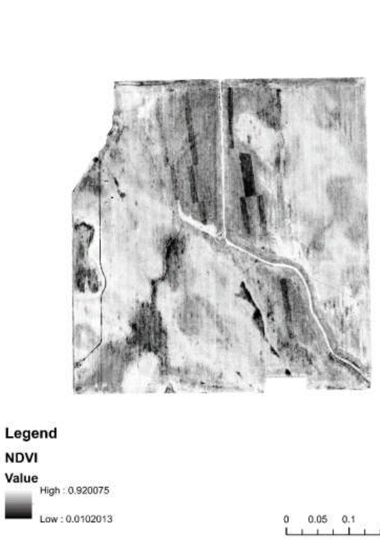
Multi-Hybrid Application for SDS Treatment
The potential exists for this technology to improve production system
Without the collection of different datasets, planning this study would not have been possible
Yield history
Documented crop scouting information
In-season aerial imagery details locations with issues
Could areas have been expanded based on imagery data?

Slide 12
Farm Scale Production Benchmarking, a Case Study in Corn Production… Multi-Hybrid Planter

Slide 13
Objectives
Create management zones that match spatial water distribution/water holding capacity of fields
Assess hybrid yield by zone delineation and verify zone structure
Determine if MH planting would be profitable

Slide 14
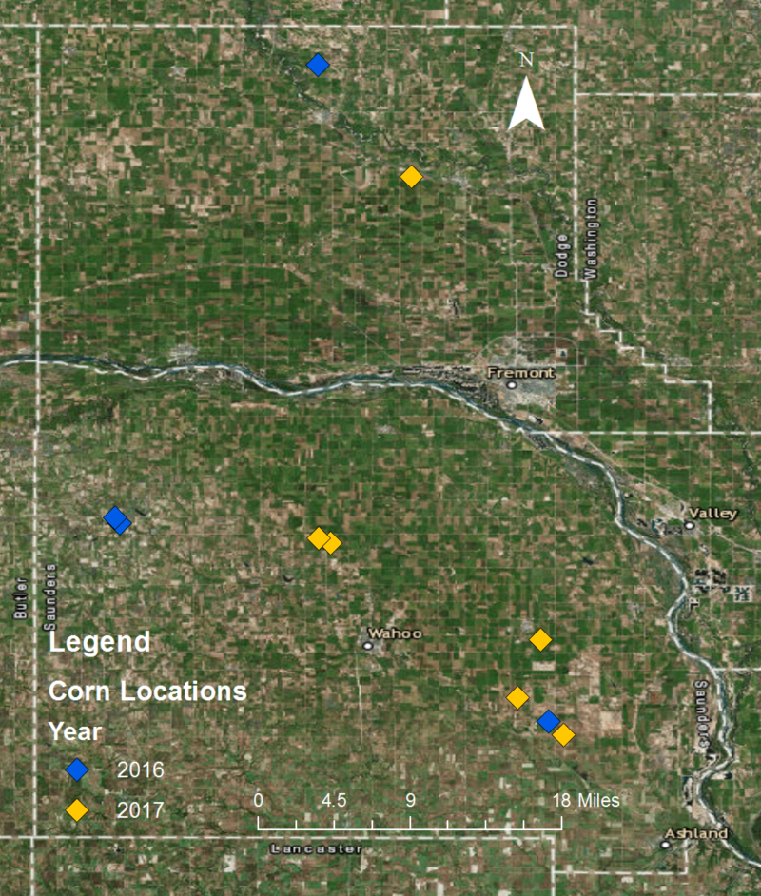
Materials and Methods: Field Sites
2016 Corn Sites
5 fields
15 different soil types
~200 acres
2017 Corn Sites
6 fields
13 different soil types
~400 acres

Slide 15
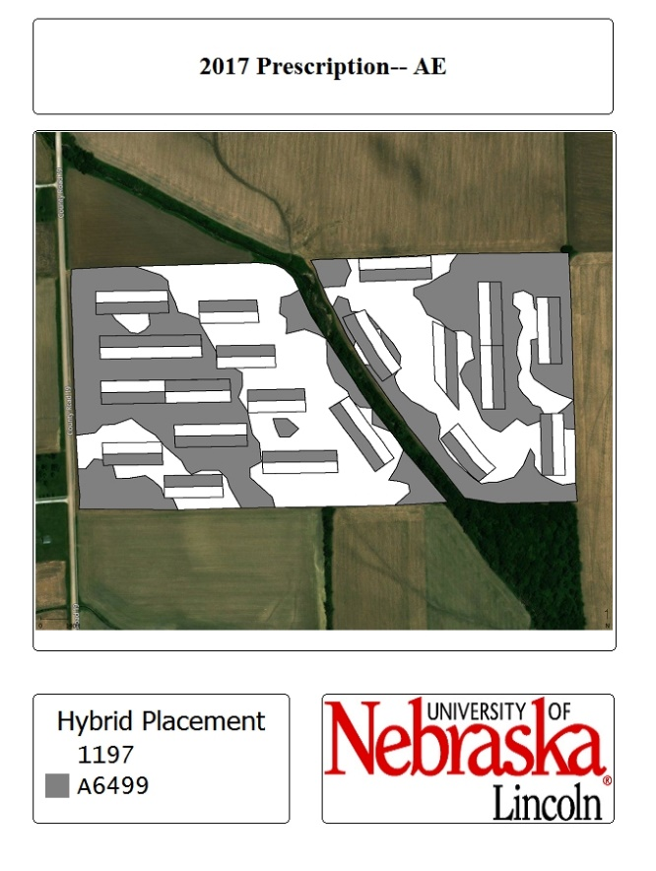
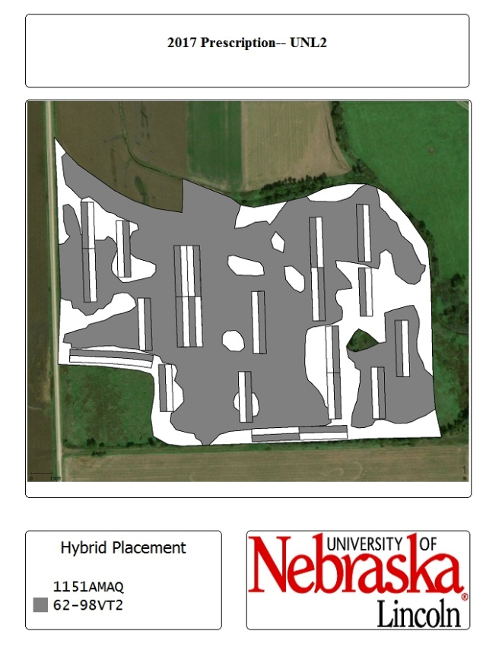
Field Layout Examples

Slide 16
2016 Yield Results Discussion
Between 11-17 cm more rainfall than 30 year average during the growing season
Yield gap existed between offensive and defensive zones
Correct zone structure?
DP, UNL1: Offensive hybrid whole field
M40, SS: No difference in hybrids
No negative consequence for planting defensive hybrid in a wet year

Slide 17
Profitability 2016
Offensive
Defensive
Zone
Zone
M40 (2016)
a
b,c
From a profitability standpoint, a single hybrid should have been planted within each field in 2016
Price of hybrid was a contributing factor
209
(Offensive)
$
663
.
28
$
625
.
62
211
(Defensive)
$
649
.
23
a,b
$
612
.
65
c
SS
P
1197
(Offensive)
$
614
.
16
a
$
589
.
10
a
P
1271
(Defensive)
$
614
.
89
a
$
599
.
92
a
DP
P
1257
(Offensive)
$
612
.
53
a
$
619
.
25
a
P
1498
(Defensive)
$
599
.
24
b
$
574
.
82
b
UNL1
P
1257
(Offensive)
$
707
.
38
a
$
677
.
11
a,b
P
1498
(Defensive)
$
660
.
34
b,c
$
643
.
25
c
Results and Discussion

Slide 18
2017 Yield Results Discussion
Between 6-10 cm more rainfall than 30 year average during the growing season
Yield gap between offensive and defensive zones
Correct zone structure?
ME, UNL3: Single hybrid whole field
M40, AE, AW : No difference in hybrids
No negative consequence for planting defensive hybrid in a wet year
UNL2: Offensive hybrid correctly placed in offensive zone, no difference in defensive zone

Slide 19
Offensive
Defensive
Profitability 2017
Zone
Zone
M40 (2017)
209
(Offensive)
$
626
.
44
a
$
549
.
29
b
211
(Defensive)
$
640
.
17
a
$
577
.
99
a,b
From a profitability standpoint, a single hybrid should have been planted within each field in 2017
Price of hybrid was a contributing factor
AE
P
1197
(Offensive)
$
493
.
07
a
$
493
.
83
a
A
6499
(Defensive)
$
510
.
08
a
$
495
.
07
a
AW
5
F
-
709
(Offensive)
$
486
.
62
a
$
457
.
12
a
830
-
39
(Defensive)
$
466
.
50
a
$
455
.
14
a
ME
1197
(Offensive)
$
633
.
95
b
$
589
.
69
a
732
-
99
(Defensive)
$
620
.
39
c
$
549
.
67
b
UNL2
62
-
98
(Offensive)
$
556
.
09
a
$
443
.
74
b
1151
(Defensive)
$
534
.
49
a
$
428
.
06
b
UNL3
P
1257
(Offensive)
$
440
.
25
b
$
356
.
31
c
P
1498
(Defensive)
$
566
.
61
a
$
478
.
10
b
Results and Discussion

Slide 20
Conclusions
Mixed results on hybrid yield by zone delineation
Adequate rainfall meant difficulty in testing management zones or defensive hybrids
No yield reduction by using a defensive hybrid in a wet year in several fields
Profitability results not necessarily correlated with yield results
Economically, a single hybrid should have been planted in all fields
Conclusion

Slide 21
Gathering Data to Begin Planning for Multi-Hybrid Applications…On Farm Research

Slide 22
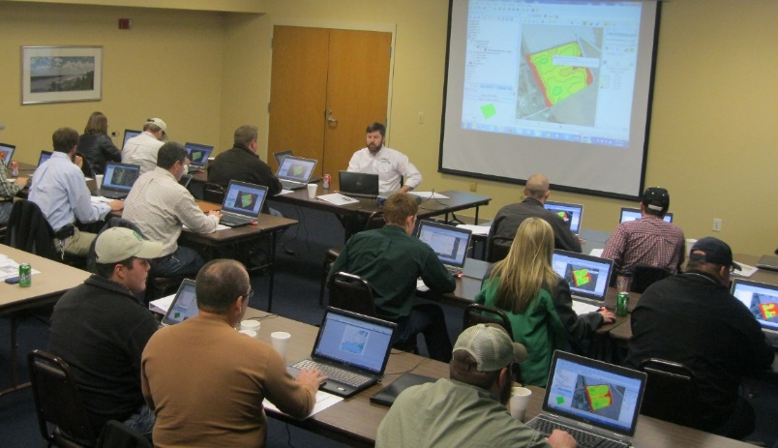
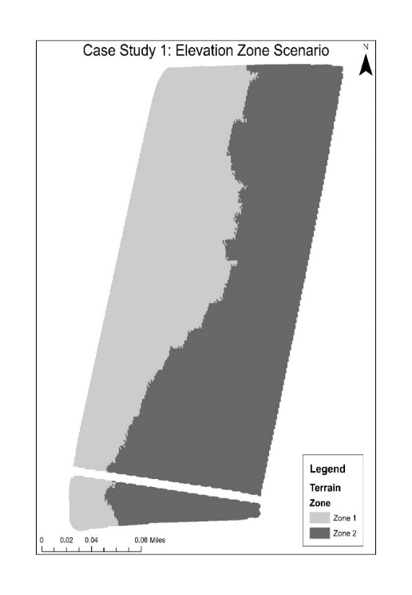
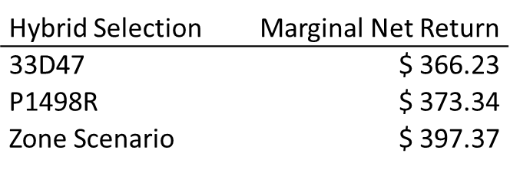
Making use of the Data
The key to harnessing these datasets for making and evaluating changes lies in the analysis (data collection is only the beginning!)
Geospatial & statistical techniques must be utilized to evaluate production changes
Split planter datasets can be an excellent way to start analyzing in-field variability based on two different treatments before investing in multi-hybrid planters
Resources for learning these techniques are available at: https://cropwatch.unl.edu/on-farm-research

Slide 23
Parting thoughts…
Benchmarking is a critical step towards continuous improvement in our production operations and understanding how changes (e.g., multi-hybrid planter adoption) might affect our operations
Consider best management practices in on-farm research as you plan such studies to get the best information possible (randomized, replicated test strips with check strips (if applicable)
As with many applications…the most persistent year-to-year issues will provide the most opportunity for quicker returns when solutions are applied.

Slide 24
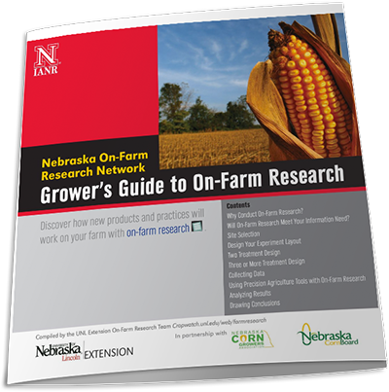
Thank you!
jluck2@unl.edu
@joeluck_unl
402-472-1488
www.precisionagriculture.unl.edu
Upcoming NE Extension On Farm Research Network Data Review Meetings:
Beatrice: Feb. 18, 9 a.m., Holiday Inn Express, 4005 N. Sixth St.
Mead: Feb. 19, 9 a.m., Eastern NE Research and Extension Center, 1071 County Road G

